Slide 1
English
Diversity Specialist
For Under-represented & At-risk Populations:
Recruitment, Retention, and Completion

Slide 2
Diversity Specialist: Our Service Area
At Green River: 31% -- where are the students of color going when they graduate from high school?

Slide 3
Diverse Populations and Needs
A diversity specialist who can teach composition and reading.
Linguistic Diversity
Multimodality—Millennials!
Multicultural Competency
Poverty & Health

Slide 4
English Division Profile
40 adjuncts
19 FT
English Department
Only one new position since 2008: Ariadne Rooney, whose focus is Tech Comm.
Internal demand for program
High-need students, including large numbers of multilingual

Slide 5
Desired Areas of Expertise
Muslim
Native American
Indigenous
Immigrants: documented, undocumented, and refugees in our service area
International and multilingual
Poverty/First Generation

Slide 6
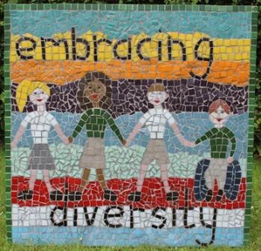
Diversity Specialist
Pedagogy and curriculum design with the diverse service community in mind
Work with ABE/ESOL on improving transition rates into academic reading and writing
Develop assessment practices germane to working with diverse student populations
Act in an advisory role to the Writing Center

Slide 7
Guided Pathways
Students from underserved populations need clear, navigable pathways through culturally responsive curriculum.
Graduates of local high schools choose other colleges
ABE/ESOL students may not transfer into academic courses

