Slide 1
GRCC Physics
New Faculty Proposal

Slide 2
GRCC Physics: Continuous growth
2003:
60% of physics classes taught by adjuncts
Full time faculty expands from 2 instructors to 3
Chitra Solomonson hired
2009:
Demand has increased by over 64%
65% of physics classes taught by adjuncts…
… so we’re back where we started, but bigger.

Slide 3
GRCC Physics: Continuous growth
2002 – 2007: 50% increase in five years
2007 – 2009: 48% increase in two years
2009 - 2010: demand keeps growing but…
Growth stops
(Well, it didn’t really stop. One section was added but Ajay was needed to teach astronomy.)

Slide 4
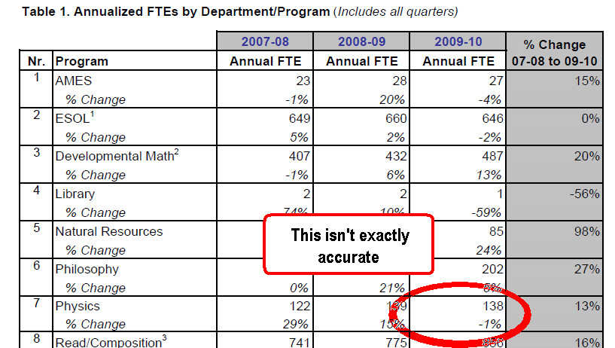
Growth didn’t quite stop:
Total students taught by the physics department grew by about 2% last year.
Ajay Narayanan also taught astronomy.

Slide 5
GRCC Physics: Continuous growth
2002 – 2007: 50% increase in five years
2007 – 2009: 45% increase in two years
2009: demand keeps growing
Growth stops
(Well, it didn’t really stop. One section was added but Ajay Narayanan was needed to teach astronomy. More on that later.)
Why? Classrooms are full (104% on average).
Why? Teacher schedules = max + moonlight
No teachers. No chairs. No more classes.

Slide 6
Demand for growth continues…
Spring 2010:
New sections of Phys 201 and Astro 101 “added” at the expense of other (full) classes
Engineering students rearrange schedules (delay graduation??) because they can’t get into physics.
Students leave GRCC to take physics at Highline, Tacoma CC, UW, and elsewhere
Summer 2010: 37 students show up for Physics 201 class with 27 seats (class capacity = 24)
Fall 2010: Another dozen students fail to get into Physics 201.

Slide 7
How great is the unmet need?
We hear from…
A dozen+ would be 200-level students a quarter
A couple of dozen would be 100-level students
At least a couple dozen would be Astro students
This year we have canceled classes for 100+ seats in survey classes to make room for science majors
We have no idea how many we don’t hear from, discouraged by long wait lists

Slide 8
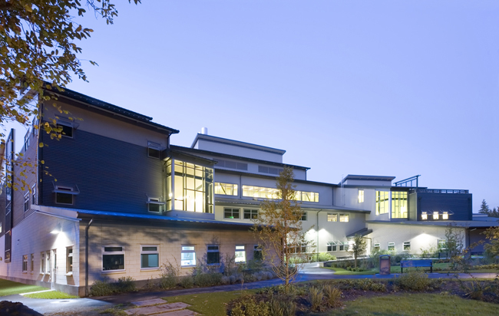
No more room…
Physics lab rooms are full 7:30 AM – 9:30 PM
Overflow has filled the schedule for SC 109
No more room in Marv Nelson SC

Slide 9
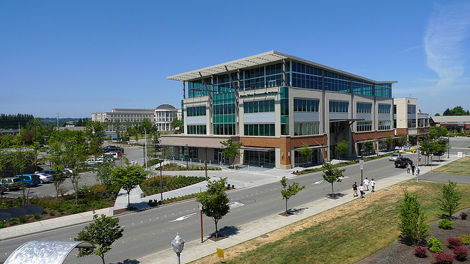
Anybody got a classroom?
If students are driving to HCC, TCC, and UW, then they would also drive to…

Slide 10
Our survey says…
Students leaving GRCC to get a physics class overwhelmingly respond that they would rather take physics at GRCC in Kent.
Schedule can be arranged to accommodate students on both campuses.
Math Division is willing to provide support.
Equipment money and lab are available.

Slide 11
The cost of expansion:
A new full-time faculty member in AUBURN
Other colleges have attempted expansion with adjuncts: and experienced not-so-pretty results.
New full-time teachers sent to branch campuses experience isolation, frustration… and often leave.
Our only plan to accommodate continued growth of GRCC physics:
One current full-time teacher (eq.) teaches in Kent.
That full-time faculty member is replaced by a new tenure-track position in Auburn.

Slide 12
The cost of no expansion:
Either:
We add a new full-time position
- or -
We fail to meet demand.

Slide 13
The cost of no expansion:
Ripple effects in STEM Programs:
Engineering (!)
Chemistry and biology
Math
and Allied Health.
Ripple effects in business and liberal arts:
2010 – 2011: 100 seats in survey classes have been cut to make room for “science major” sequences

Slide 14
Where’s the increase in demand?
Mostly engineers (75% increase in Phys 201)
These students will leave to get physics elsewhere
International students (50% of the increase)
Biology and health (50% increase in Phys 111)
AA-DTA students and business majors
33% increase in Phys 105 and Phys 110
Astronomy (especially for future teachers)
Full Physics 105 cut to make room for Astro 101.
There is demand for 50% increase in Astro 101.

Slide 15
Is it just the economy???
Physics enrollment at HCC has been flat.
Fewer than 20 sections per year
Physics at GRCC and Bellevue:
Bellevue College:
30,000 students
55 sections of physics per year
GRCC
10,000 students
54 sections of physics per year

Slide 16
The future…
The physics faculty, dean, and lab-tech have brainstormed.
We’ve met with faculty in math, chemistry, and engineering.
We don’t see a way to grow to meet the unmet need…
…without expanding into Kent and hiring another full time teacher.

Slide 17
New Physics Faculty Proposal
The cost of no expansion:
As far as we can figure out, either:
We add a new full-time position
- or -
We fail to meet demand.

