Slide 1
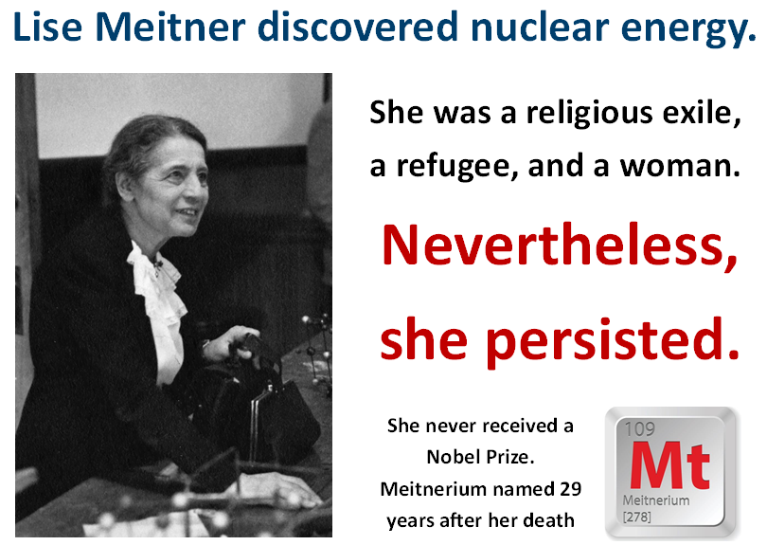
She did not receive a
Nobel Prize.
The element Meitnerium was named
for her, 30 years after her death.

Slide 2
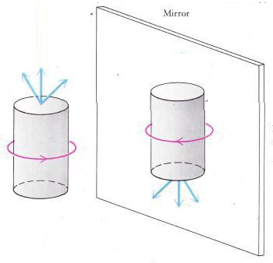
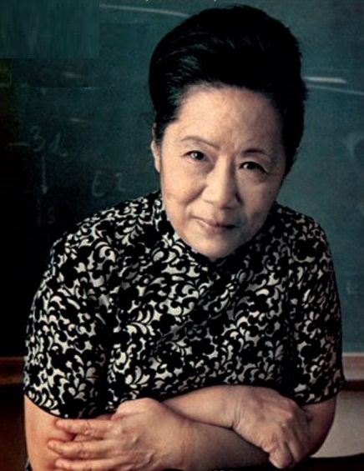
Particle physics is different reflected in a mirror.
Discovered by C.S. Wu in 1956.
She did not receive a
Nobel Prize.
Two men did.
Irony: her discovery is known as non-conservation of parity.

Slide 3
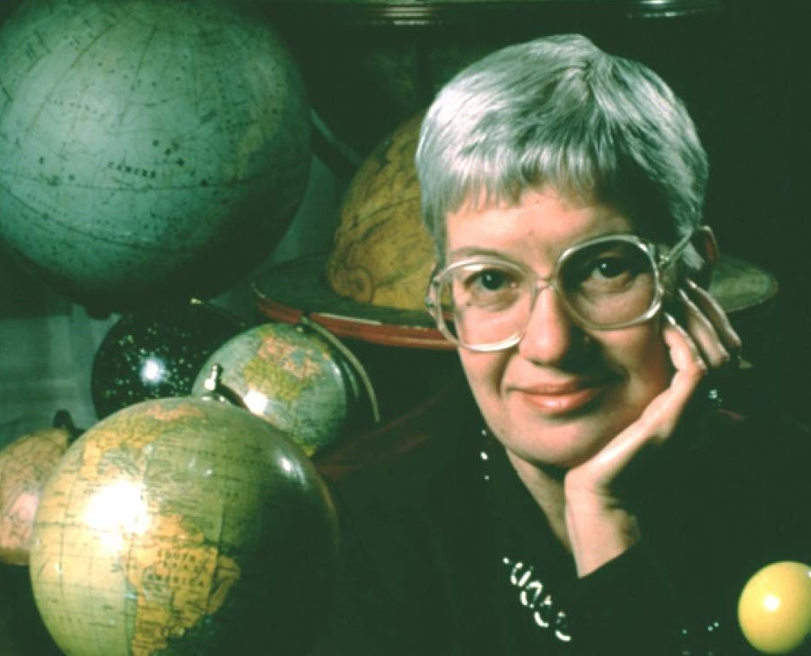
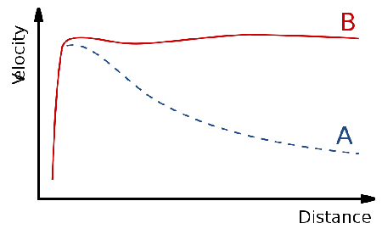
We believe 80% of the universe is Dark Matter.
We learned this from the work of Vera Rubin.
She did not receive a
Nobel Prize.
She died in 2016.

Slide 4
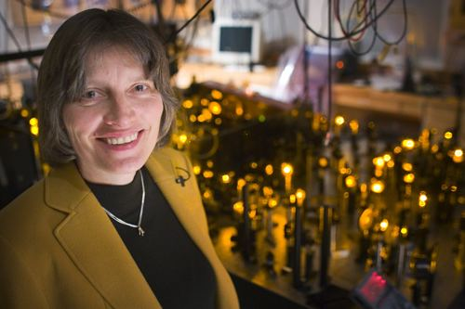
Lene Hau studies light and matter.
She has converted light to matter, moved it to a new location, and started it up again.
She was originally denied funding for
her research.
Nevertheless,
she persisted.
Is a Nobel Prize
in her future?

Slide 5
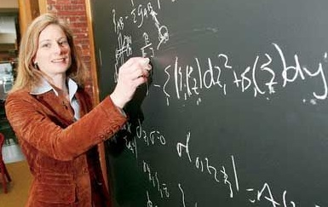
Lisa Randall studies general relativity.
She is a professor of physics at Harvard.
She is a Guggenheim Fellow.
One of TIME’s most influential 100 people of 2007.
Much-hated nickname on Harvard campus:
“The Physics Babe”

Slide 6
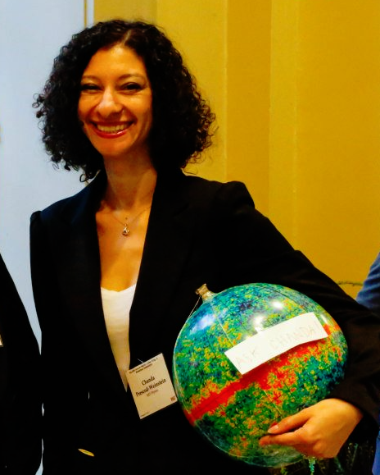
Chanda Prescod-Weinstein
studies cosmology.
They completed post-docs
at MIT and the UW.
They have begun studying the effect of a lack of diversity among physicists, on a lack of diversity of ideas in physics.
Only the 63rd African-American
woman to earn a PhD in Physics.

