Slide 1

She did not receive a
Nobel Prize.
The element Meitnerium was named
for her, 30 years after her death.

Slide 2
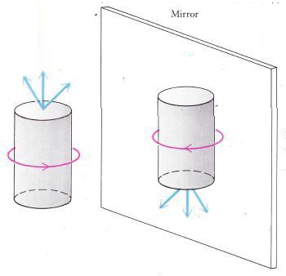
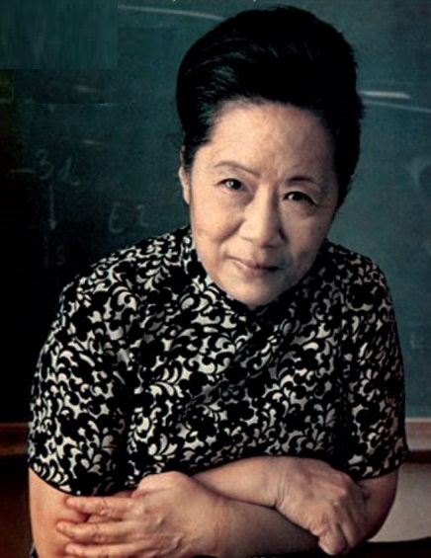
Particle physics is different reflected in a mirror.
Discovered by C.S. Wu in 1956.
She did not receive a
Nobel Prize.
Two men did.
Irony: her discovery is known as non-conservation of parity.

Slide 3
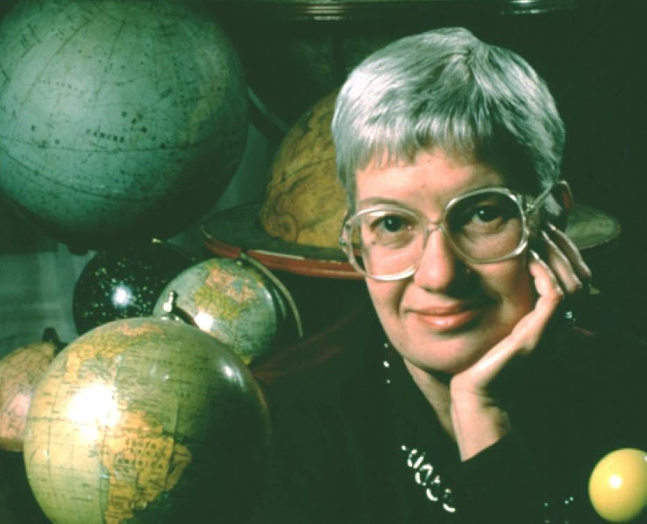
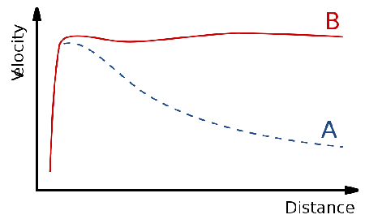
We believe 80% of the universe is Dark Matter.
We know because of the work of Vera Rubin.
She did not receive a
Nobel Prize.
She died in 2016.

Slide 4
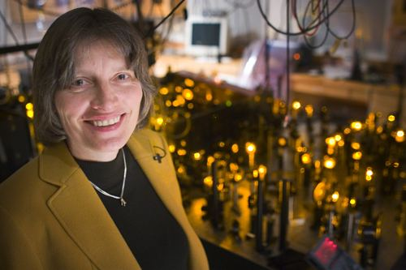
Lene Hau studies light and matter.
She has converted light to matter, moved it to a new location, and started it up again.
Denied funding for
this research,
NEVERTHELESS
SHE PERSISTED
Is a Nobel Prize
in her future?

Slide 5
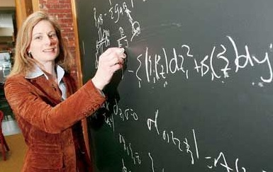
Lisa Randall studies general relativity.
She is a professor of physics at Harvard.
She is a Guggenheim Fellow.
One of TIME’s most influential 100 people of 2007.
Much-hated nickname on Harvard campus:
The Physics Babe

Slide 6
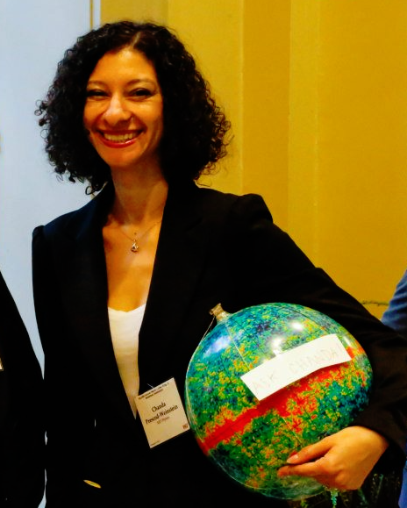
Chanda Prescod-Weinstein
studies cosmology.
They completed post-docs
at MIT and the UW.
They have begun studying the effect of a lack of diversity among physicists, on a lack of diversity of ideas in physics.
Only the 63rd African-American
woman to earn a PhD in Physics.

Slide 7
SEEKING
Women in STEM –
Persistence Required
Statistics, Studies and Stories
A talk by Keith Clay

Slide 8
The gender gap in STEM
How bad is it?
Why is it there?
What can we do?

Slide 9
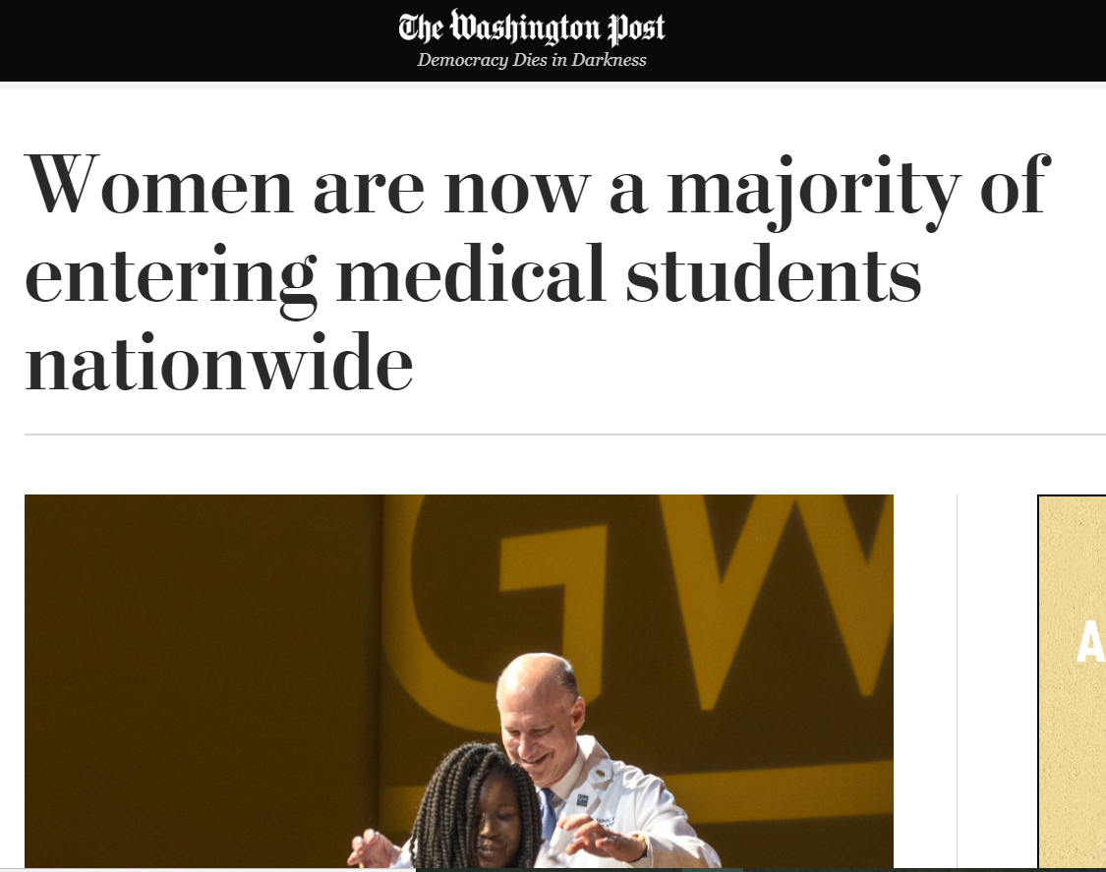
Women in medical school: 2017

Slide 10
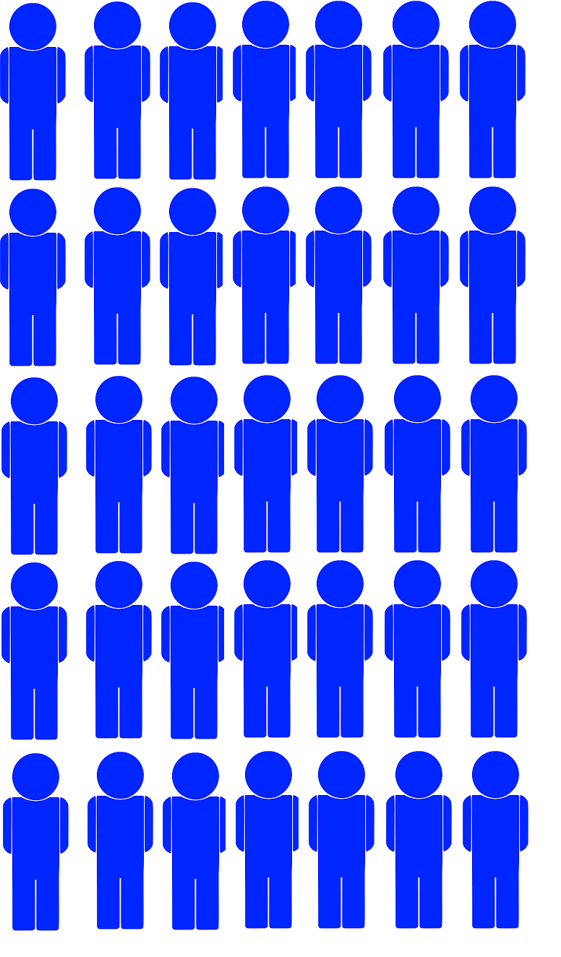
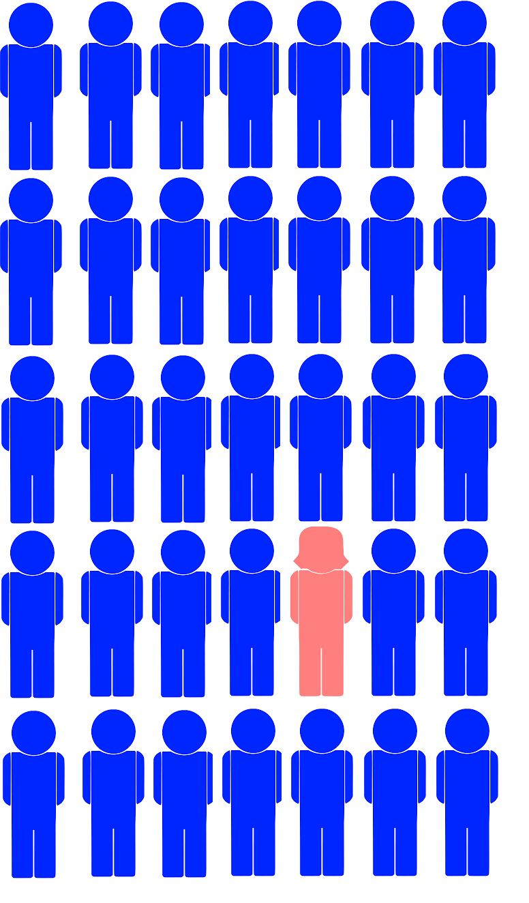
Women in physics grad school: 2018
Entering class:
University of Washington
Department of Physics
Fall 2018
35 students
1 woman

Slide 11
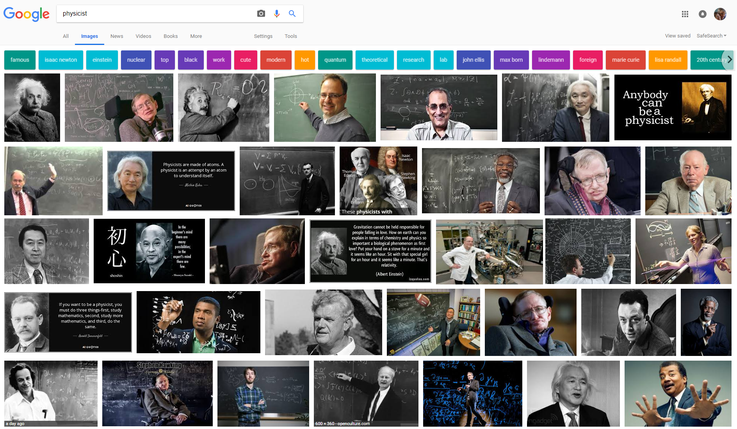
Is physics really all that male?
Let’s ask Google…

Slide 12
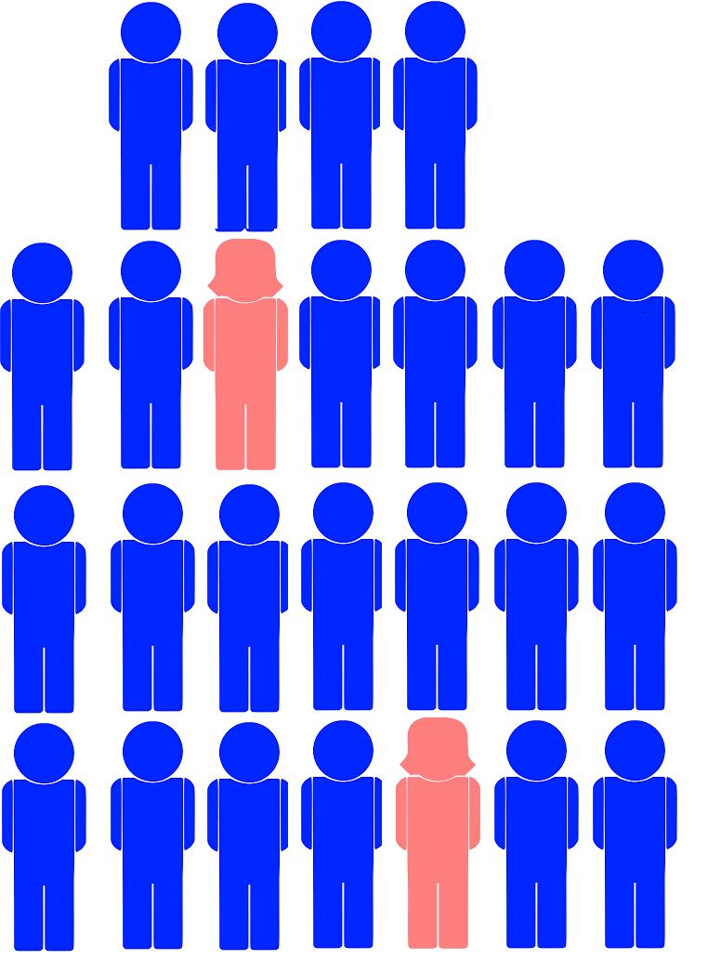
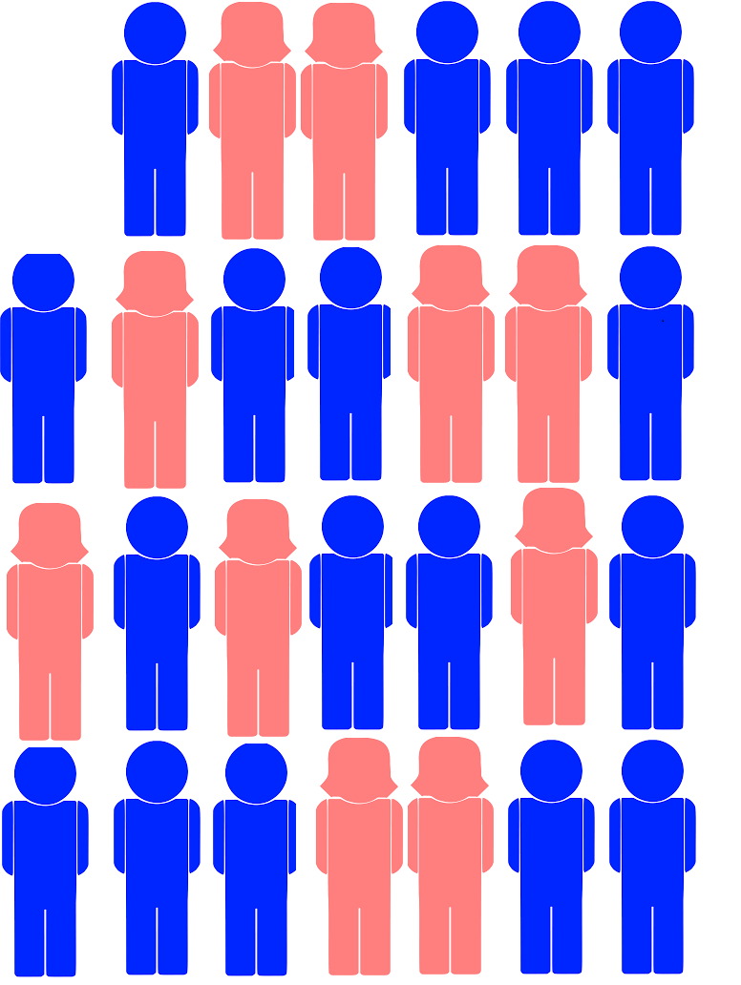
Is physics really all that male?
Let’s check Green River…
Keith’s Phys 222 class
Keith’s Phys 223 class

Slide 13

Is physics really all that male?
Let’s check Green River…
20% women
Typical 200-level physics class at Green River

Slide 14
Percent of Bachelor’s Degrees Earned by Women in Selected Fields, 1966-2001.
2001
Source: National Center for Education Statistics. Data for Academic Year 1999 were not available. Compiled by AIP Statistical Research Center.

Slide 15
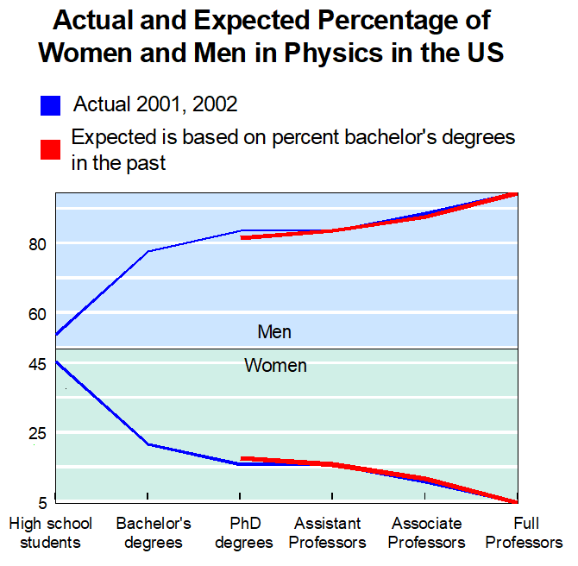
Do physics majors matter?

Slide 16
Percent of Bachelor’s Degrees Earned by Women in Selected Fields, 1966-2001.
2001
Source: National Center for Education Statistics. Data for Academic Year 1999 were not available. Compiled by AIP Statistical Research Center.

Slide 17
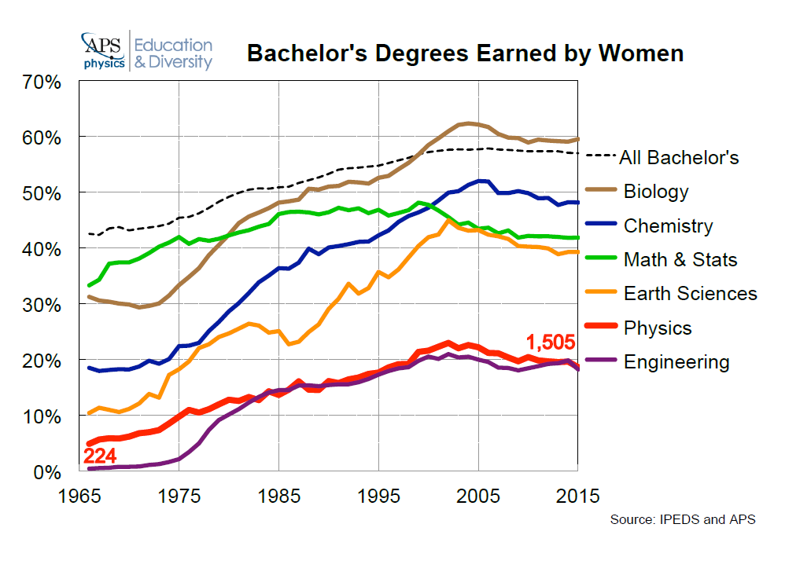
Percent of Bachelor’s Degrees Earned by Women in Selected Fields, 1966-2001.
2015

Slide 18
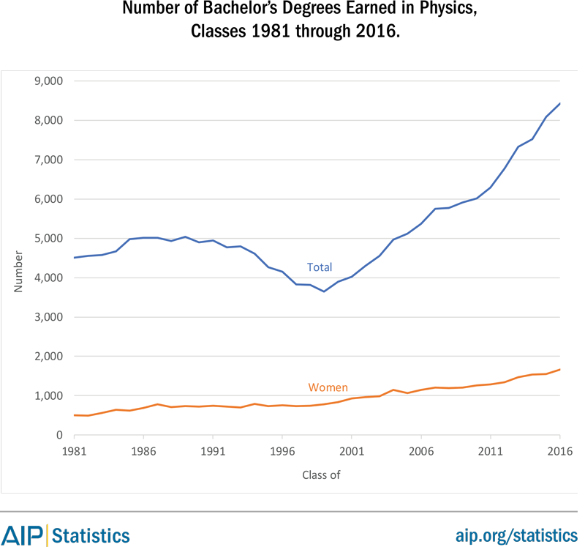
Percent of Bachelor’s Degrees Earned by Women in Selected Fields, 1966-2001.
Number

Slide 19
Percent of Bachelor’s Degrees Earned by Women in Selected Fields, 1966-2001.
2015
White and Asian

Slide 20
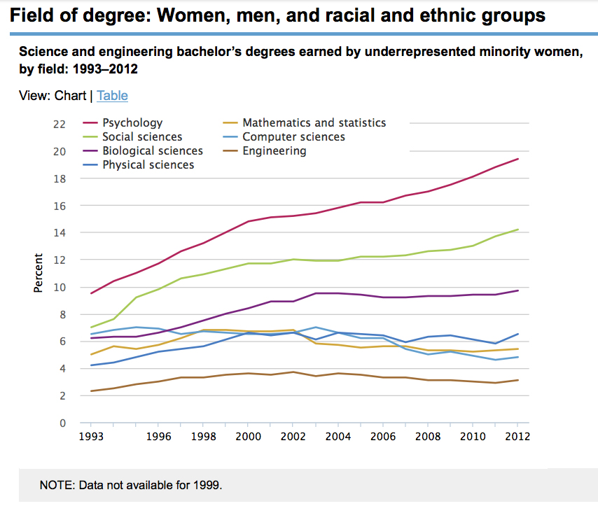
Intersectionality: Women of (URM) color

Slide 21
Why is there a gender gap?
Maybe women are “less able”
January 2005…
Harvard President Laurence Summers:
Perhaps we should investigate whether women are innately less able than men in math and science.
(paraphrased: the exact quote is not available)

Slide 22
Why is there a gender gap?
Maybe women are “less able”
Consider the case of Rachel Ivie
She became a Statistician.
Took a job with Statistical Research Center at Amer. Institute of Physics.
Dec. 2004:
Authored study on women in physics.
Prepared for long winter’s nap.
Jan. 2005:
Summers voices
“less able” idea
The next day:
Time, Newsweek, NYT, Washington Post, and NPR descend on AIP!

Slide 23
Why is there a gender gap?
Maybe women are “less able”
no

Slide 24
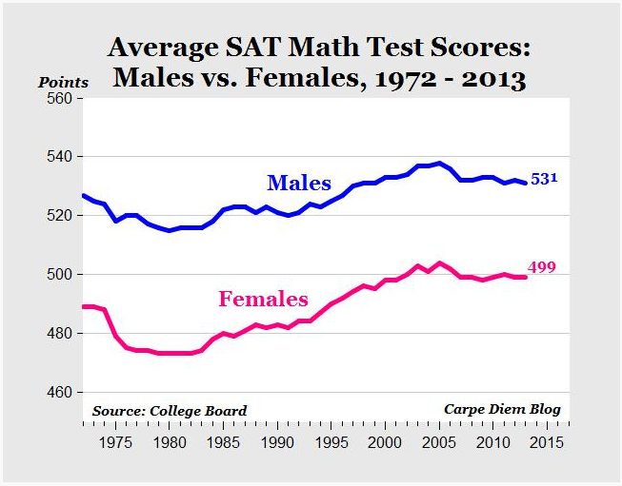
Why is there a gender gap?
Maybe women are “less able”
The “achievement” gap
Men earn higher scores than women on SAT and GRE quantitative tests.

Slide 25
Why is there a gender gap?
Maybe women are “less able”
The “achievement” gap?
“An April 1995 study at UC Berekeley found that women with identical academic indexes” (test scores) “to men obtained higher grade point averages in every major on campus, including math and physical sciences.”
“The report concluded that women should have about 140 points added to their index to compensate for the SAT's underprediction…”
American Physical Society, 1996

Slide 26
Why is there a gender gap?
Maybe women are “less able”
The “achievement” gap?
Men earn higher scores than women on SAT and GRE quantitative tests.
The difference is much less than 140 points

Slide 27
Why is there a gender gap?
Maybe women are “less able”
“A joint study by the ETS and the College Board concluded that multiple choice formats favor men over women…”
American Physical Society, 1996

Slide 28
Why is there a gender gap?
Maybe women are “less able”
“Consistent under prediction of women's performance in college mathematics courses provides evidence that the SAT-M, used alone, is mismeasuring the profile of proficiencies that contribute to success in college."
Howard Wainer and Linda Steinberg of
Educational Testing Service quoted in
Gender Bias in College Admissions Tests 2007

Slide 29
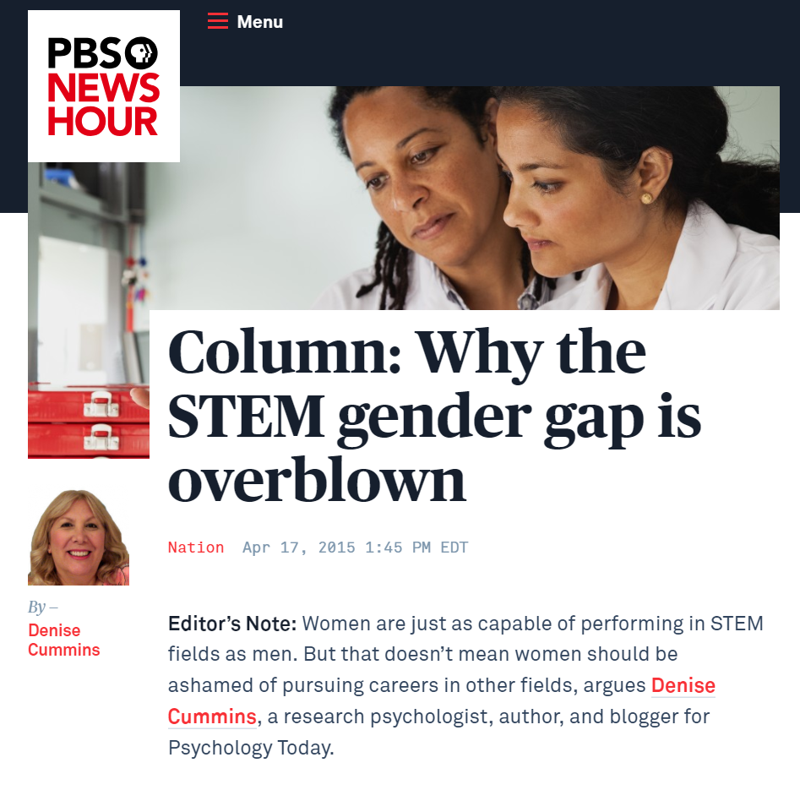
Why is there a gender gap?
Maybe women choose other things
“We also should not be ashamed if our interests differ from men’s. If we find certain careers more intrinsically rewarding than men do, that does not mean we have been brainwashed by society or herded into menial fields of labor. Instead, we should demand that greater intrinsic and monetary compensation be awarded to the work we like and want to do.”
Dr. Denise Cummings
Research psychologist

Slide 30
Why is there a gender gap?
Maybe women choose other things
Why would women choose to study other things?

Slide 31
Why is there a gender gap?
Maybe women choose other things
Student story 1:
A female computer science student is assigned to a class project with a male classmate.
She has started the project and written subroutines in advance.
The male student won’t let her touch the keyboard or contribute.
She objects, saying she should be allowed to help.
He asks her if she can get him something to eat.

Slide 32
Why is there a gender gap?
Maybe women choose other things
Student story 2:
A female science student is accepted into a research laboratory.
Male professor assigns her to work with a male post-doctoral researcher.
She detects awkwardness and reluctance on the part of the post-doc.
She asks if there is a problem.
The post-doc says he doesn’t understand women.

Slide 33
Why is there a gender gap?
Maybe women choose other things
Student story 3:
A female student is working in the lab of a prestigious male scientist.
An experiment fails. She reports to the scientist that she needs to restart the experiment.
The male scientist gets angry and shouts...
“You… You… YOU… WOMAN!”
(Editor’s note: Technically he was correct.)

Slide 34
Why is there a gender gap?
Maybe women choose other things
Student story 4:
A male department head invites a male STEM student to dinner to congratulate him on upcoming graduation.
The male student is confused and asks what about a female classmate. She’s graduating, too. Shouldn’t she come to dinner?
The male department head agrees and says…
“Great idea…
I’ll bring my wife so she has someone to talk to.”

Slide 35
Why is there a gender gap?
Maybe women choose other things
Student story 1: Woman changed her major.
Student story 2: Woman found another lab.
Student story 3: Woman did not complete her degree.
Student story 4: Everybody went to dinner.
It is hard to blow the whistle.

Slide 36

Why is there a gender gap?
Maybe women choose other things
“Another common but somewhat misguided explanation for female underrepresentation in STEM is that while girls and young women may be just as able as young men, they are not as interested in science and engineering. From adolescence, girls report less interest in math and science careers than boys do (Turner et al. 2008), and among children identified as mathematically precocious, girls were less likely than boys to pursue STEM careers as adults (Lubinski and Benbow 2006). Girls’ lower reported interest in STEM may be partially explained by social attitudes and beliefs about whether it is appropriate for girls to pursue these subjects and careers.”
Dr. Catherine Hill, 2010

Slide 37
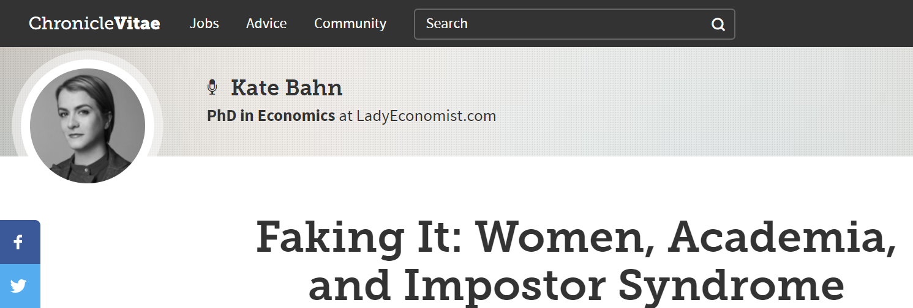
Why is there a gender gap?
Maybe women choose other things
“Impostor syndrome—the feeling that, regardless of your accomplishments, you’re still about to be unmasked as a fraud—is an all-too-common affliction among academics… While both men and women experience impostor syndrome, women are far more susceptible.”

Slide 38
Why is there a gender gap?
Maybe women choose other things
“The survey’s findings point to “the pressure to look or dress a certain way” and “the hookup culture” as major contributors… If a female student feels insecure about her looks, that may leave her feeling less confident in other areas, including the classroom.”

Slide 39
Why is there a gender gap?
Maybe women choose other things
“There are few injustices deeper than the denial of an opportunity to strive or even to hope, by a limit imposed from without, but falsely identified as lying within.”
Stephen Jay Gould, 1981

Slide 40

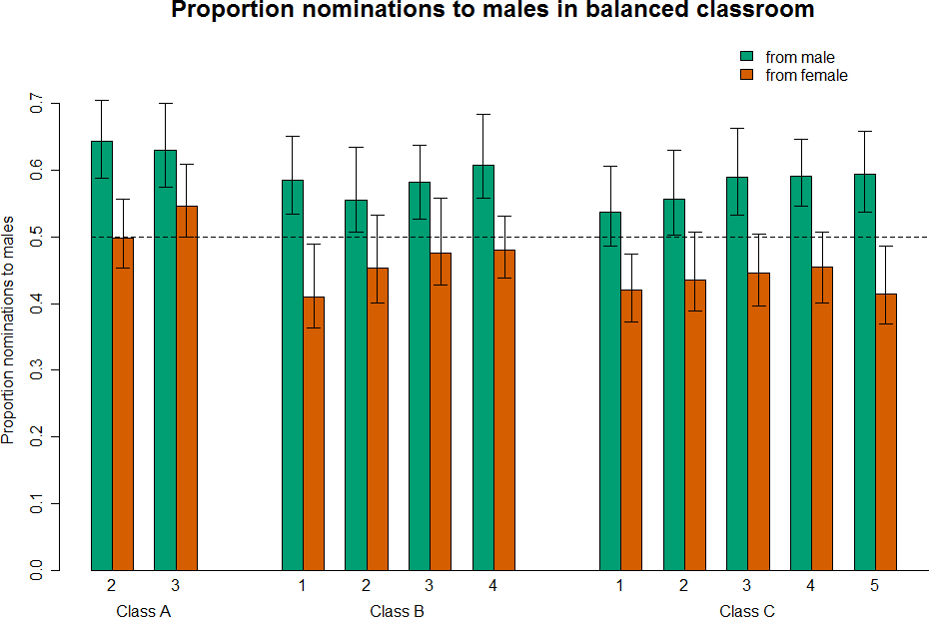
Why is there a gender gap?
What about classmates?
Daniel Z. Grunspan,
Sarah L. Eddy,
Sara E. Brownell,
Benjamin L. Wiggins,
Alison J. Crowe, and
Steven M. Goodreau

Slide 41




Why is there a gender gap?
What about classmates?
A-
B-
B-
B+
C
A
C-
A
A-
B-
C-

Slide 42
Why is there a gender gap?
What about classmates?
At the start of the term:
  men underestimate female classmates
  women slightly overestimate female classmates
Later in the term:
  men still underestimate female classmates
  women start to underestimate female classmates
Even at the start of the term:
Men underestimate women 19 times as much
as women overestimate women
And this is happening in BIOLOGY:
A field where headcounts suggest
there is gender parity

Slide 43
What’s in a word?
Please join in a short experiment.
Think of the first images that come to mind when you hear…

Slide 44

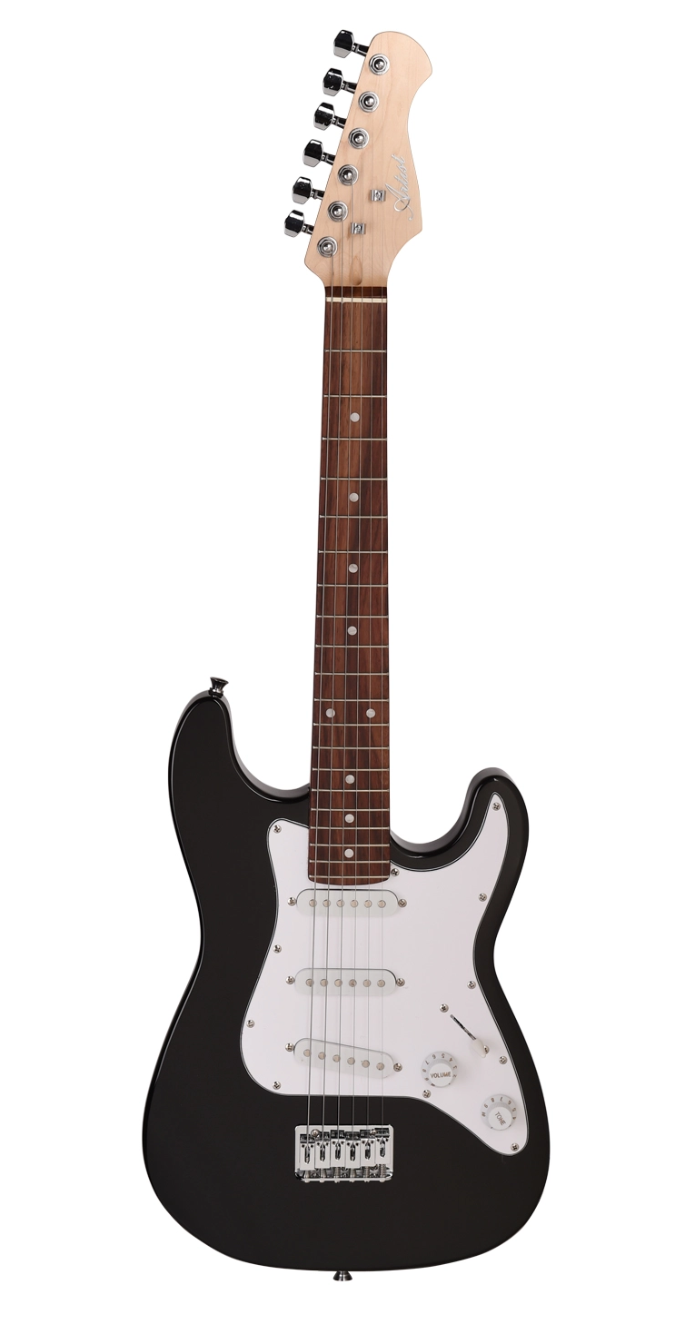
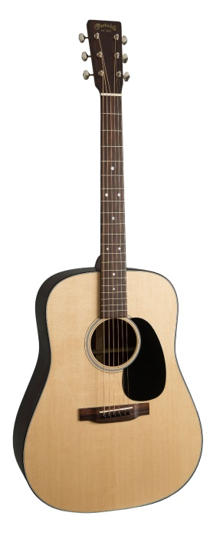

What’s in a word?

Slide 45


What’s in a word?

Slide 46
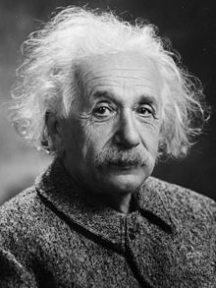

What’s in a word?

Slide 47
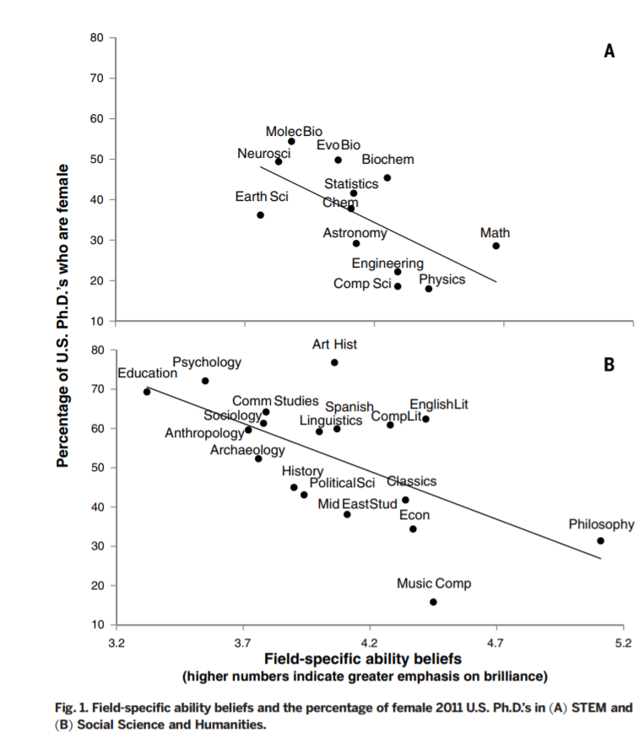
What is needed for success in science?
Innate ability or potential to learn?
Field-specific
ability beliefs
Disciplines most associated with “innate ability”
are most heavily dominated by men.
Meredith Meyer, Andrei Cimpian, Sarah-Jane Leslie, Edward Freeland
January 2015

Slide 48
What is needed for success in science?
But wait. Maybe it’s not FAB. Maybe it’s…

Slide 49
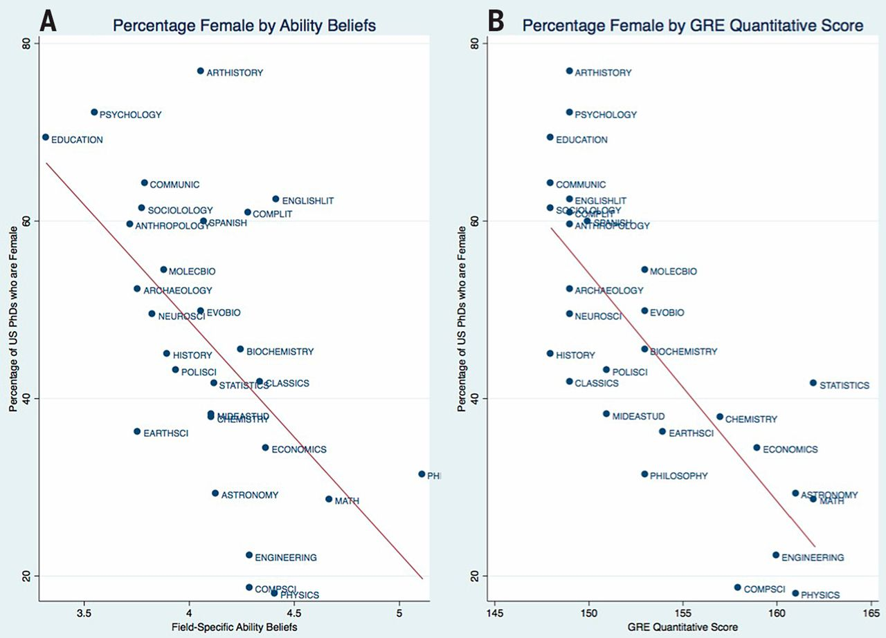
What is needed for success in science?
Quantitative GRE scores!
Quantitative GRE scores produce a
similar graph
Donna K. Ginther, Shulamit Kahn
July 2015

Slide 50
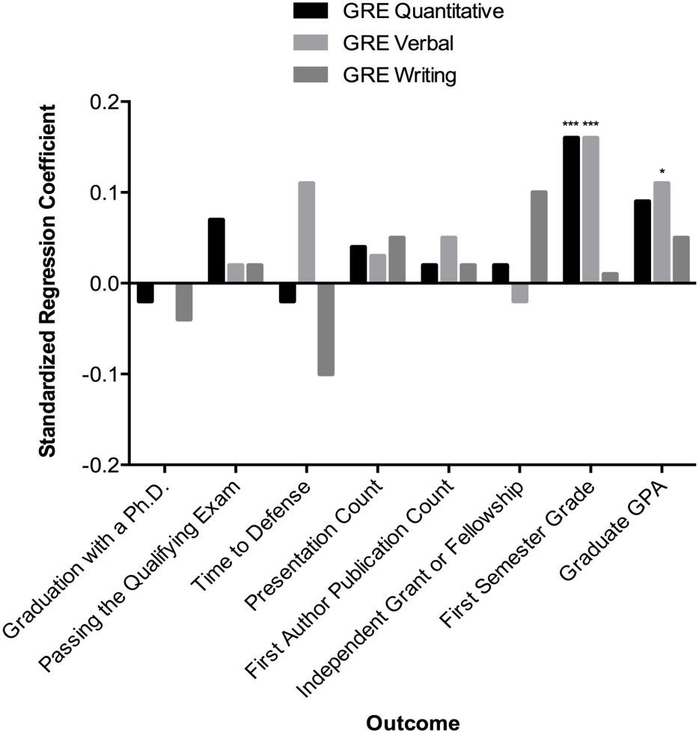
What is needed for success in science?
Are GRE scores useful predictors?
Research?
GRE scores predict good grades, not research success.
Grades!
Liane Moneta-Koehler, Abigail M. Brown, Kimberly A. Petrie, Brent J. Evans, Roger Chalkley, 2017
Vanderbilt biological sciences

Slide 51
What is needed for success in science?
Are GRE scores useful predictors?
“While there was a very slight correlation between GRE scores and graduate course grades, there was no correlation with other measures of success in graduate school”
David Morin, 1996
Harvard Dept. of Physics

Slide 52


What is needed for success?
What do grad schools look for?
Grades, GRE scores, “diamonds in the rough”
“geniuses”…
Curiosity, diligence, interest in learning, “scientists”…
Low percentage of women in department
Higher percentage
of women admitted
Rachel Scherr, November 2017

Slide 53
What is needed for success?
What do grad schools look for?
“A fixed mindset … identifying physics as a “brilliance-required” field … that raw, innate talent is a primary requirement for success... directly affects the participation of women … who are stereotyped as lacking… high-level intellectual ability.”
Rachel Scherr, November 2017

Slide 54
What can we do?
I don’t know but…

Slide 55
What can we do?
STUDENTS:
NEVERTHELESS, PERSIST
Talk to each other, men and women
Consider blowing the whistle

Slide 56
What can we do?
TEACHERS:
Talk about it
Think about it
Teach about it

Slide 57
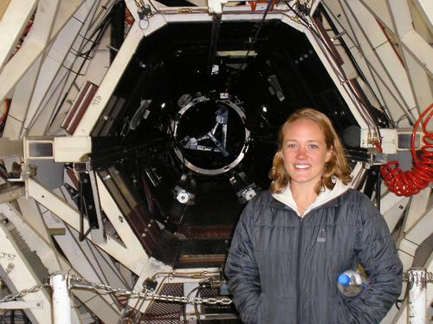
What can we do?
Teach about it
South Seattle College teaches about gender and ethnicity…
… in Physics classes
Abigail Daane
South Seattle College

Slide 58
What can we do?
INSTITUTIONS:
Listen for it
Create “low volume whistles”
Create space for women and minorities

Slide 59


Creating space…
Mathematics, Engineering, Science Achievement (MESA) provides support for under represented students in math and science, helping them attain four-year degrees in STEM fields.
Kristine Schroeder
Green River College
MESA Director

Slide 60
What can we do?
ALL OF SOCIETY:
We need to change
the way we think

Slide 61
A final
thought…

Slide 62
Just one
word…
Remember this image

Slide 63
Thank
you

Slide 65
Links to statistics, articles, and papers
All of the articles and most of the original research mentioned in this presentation can be found online.
Page one…
American Institute of Physics, Statistical Research Center, https://www.aip.org/statistics/data/women
College Board, SAT Total Group Profile Report http://media.collegeboard.com/digitalServices/pdf/research/2013/TotalGroup-2013.pdf
American Physical Society News, vol. 5, #7, July1976, Fighting the Gender Gap: Standardized Tests Are Poor Indicators of Ability in Physics, https://www.aps.org/publications/apsnews/199607/gender.cfm
Wainer, Howard and Steinberg, Linda, Educational Testing Service, quoted in FairTest, Gender Bias in College Admissions Tests, August 20, 2007, https://www.fairtest.org/gender-bias-college-admissions-tests

Slide 66
Links to statistics, articles, and papers
Page two…
Cummings, Denise, Why the STEM Gender Gap is Overblown, PBS News Hour, 2015, https://www.pbs.org/newshour/nation/truth-women-stem-careers
Hill, Catherine, American Association of University Women, Why So Few?, 2010 https://www.aauw.org/research/why-so-few/
Bahn, Kate, Faking It: Women, Academia, and Impostor Syndrome, Chronicle Vitae, March 27, 2014, https://chroniclevitae.com/news/412-faking-it-women-academia-and-impostor-syndrome
Gould, Stephen J., 1996 The Mismeasure of Man, New York, N.Y.: Norton.
Grunspan, Daniel Z., Eddy, Sarah L., Brownell, Sara E., Wiggins, Benjamin L., Crowe, Alison J., Goodreau, Steven M., Males Under-Estimate Academic Performance of Their Female Peers in Undergraduate Biology Classrooms, February 10, 2016, http://journals.plos.org/plosone/article?id=10.1371/journal.pone.0148405
Leslie, Sarah-Jane, Cimpian, Mayer, Meredith, Freeland, Edward, Expectations of brilliance underlie gender distributions across academic disciplines, Science, Jan. 2015, http://science.sciencemag.org/content/347/6219/262

Slide 67
Links to statistics, articles, and papers
Page three
Ginther, Donna K., and Kahn, Shulamit, Comment on “Expectations of brilliance underlie gender distributions across academic disciplines”, Science, July 2015, http://science.sciencemag.org/content/sci/349/6246/391.2.full.pdf?sid=fbf0dd62-c973-497d-902c-e1a80bfbe0ea
Moneta-Koehler, Liane, Brown, Abigail M., Petrie, Kimberly A., Evans, Brent J., Chalkley, Roger, The Limitations of the GRE in Predicting Success in Biomedical Graduate School, PLOS one, January 2017, http://journals.plos.org/plosone/article?id=10.1371/journal.pone.0166742
Scherr, Rachel, Plisch, Monica, Gray, Kara, Potvin, Geoff, Hodapp, Ted, Fixed and growth mindsets in physics graduate admissions, Physical Review: Physics Education Research, 29 November 2017, https://journals.aps.org/prper/abstract/10.1103/PhysRevPhysEducRes.13.020133

