Slide 1
Measurement & Dimensions
Don’t do science without them.

Slide 2
Why do scientists measure things?
It’s so much fun
They’re paid millions to do it
It makes them feel superior
It is difficult to make predictions otherwise

Slide 3
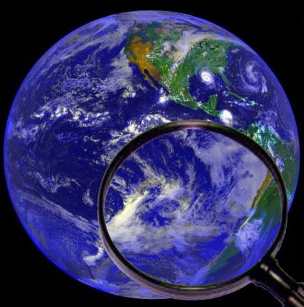
How science works
Prediction
Experiment
Mental Model
Idea
Observation

Slide 4
Measurements make predictions testable.
“If I drop a rock, it will fall.”
When?
How long would we have to wait to prove this statement false?
What is meant by “fall”?
Is “moving down” the same as “falling”?

Slide 5
What to measure?
We only need to measure three things: Length (L), Mass (M), and Time (T)
We could have chosen three other things (such as density, velocity, and force)
Length, Mass, and Time “feel” fundamental

Slide 6
What to measure?
We call Mass, Length, and Time “Dimensions”
This is NOT the same meaning of the word as when we say a square is two-dimensional and a cube is three-dimensional. When we say a square is two-dimensional, both of those dimensions are dimensions of length.

Slide 7
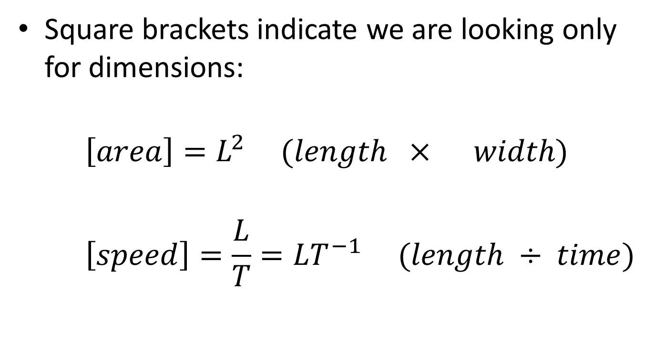
Dimensions
Square brackets indicate we are looking only for dimensions:
$$\left[area\right]=L^{2} (length × width)$$
$$\left[speed\right]=\frac{L}{T}=LT^{−1} (length ÷ time)$$

Slide 8
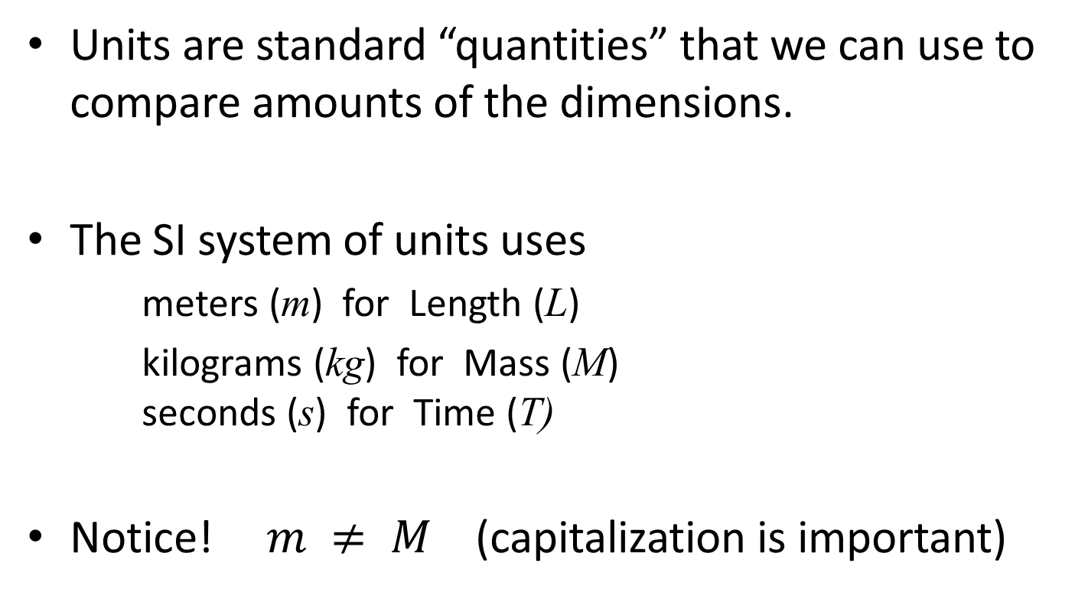
Units
Units are standard “quantities” that we can use to compare amounts of the dimensions.
The SI system of units uses
meters (m) for Length (L)
kilograms (kg) for Mass (M) seconds (s) for Time (T)
Notice! $m ≠ M$ (capitalization is important)

Slide 9
Unit conversions
Converting from one set of units to another can be tricky in complicated situations.
The following are definitions:
1 inch = 2.54 cm
100 cm = 1 m
12 inches = 1 foot
5280 feet = 1 mile and 1 furlong = 1/8 mile
Ten furlongs is equal to how many meters?

Slide 10
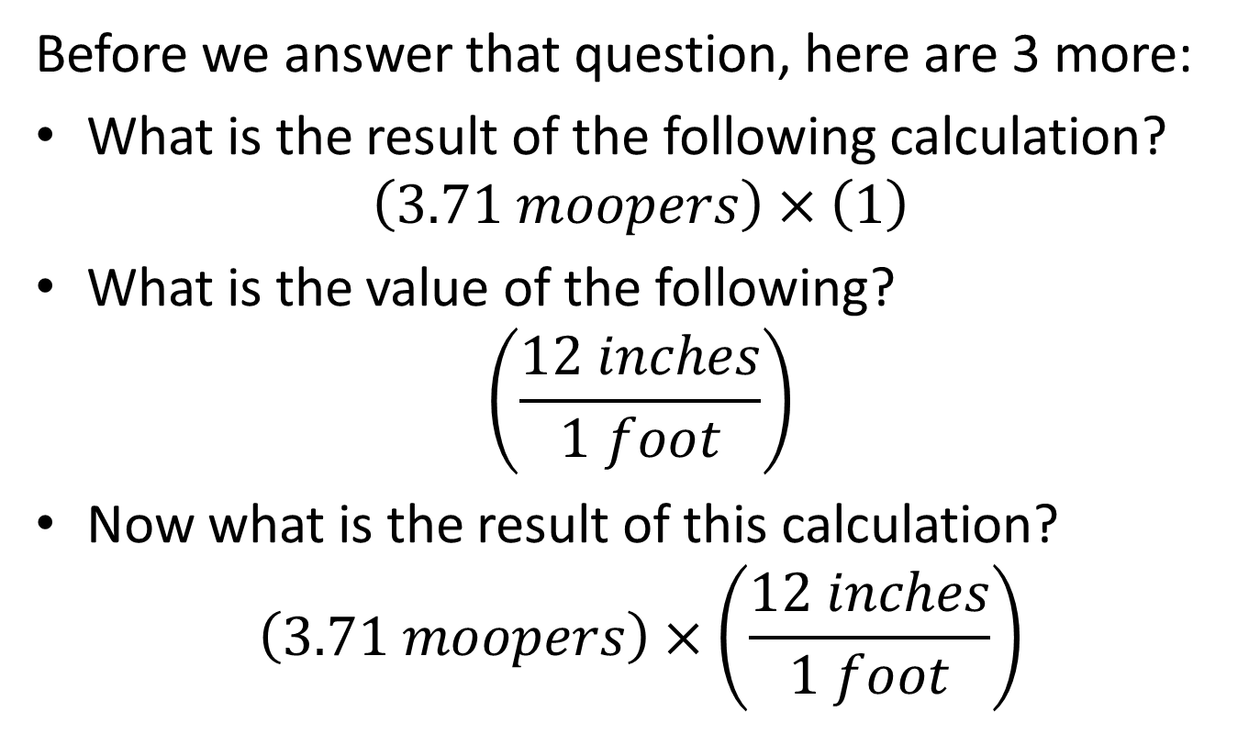
Unit conversions
Before we answer that question, here are 3 more:
What is the result of the following calculation? $\left(3.71 moopers\right)×\left(1\right)$
What is the value of the following?
$$\left(\frac{12 inches}{1 foot}\right)$$
Now what is the result of this calculation?
$$\left(3.71 moopers\right)×\left(\frac{12 inches}{1 foot}\right)$$

Slide 11
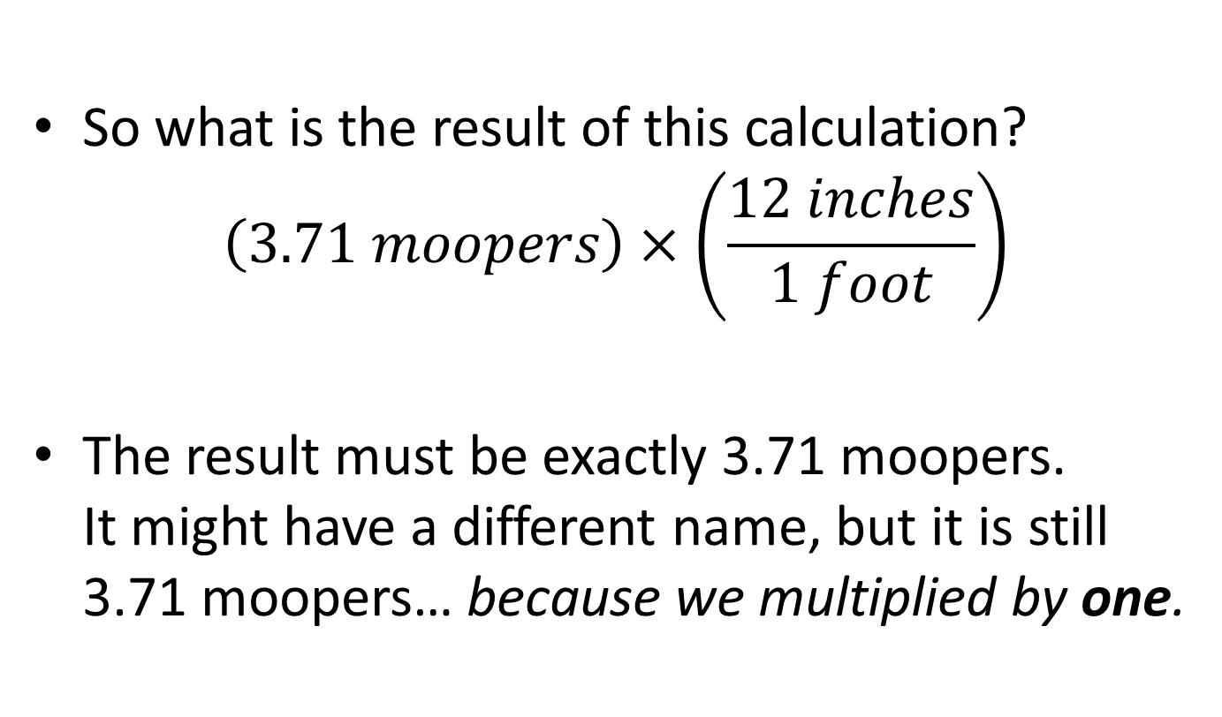
Unit conversions
So what is the result of this calculation?
$$\left(3.71 moopers\right)×\left(\frac{12 inches}{1 foot}\right)$$
The result must be exactly 3.71 moopers. It might have a different name, but it is still 3.71 moopers… because we multiplied by one.

Slide 12
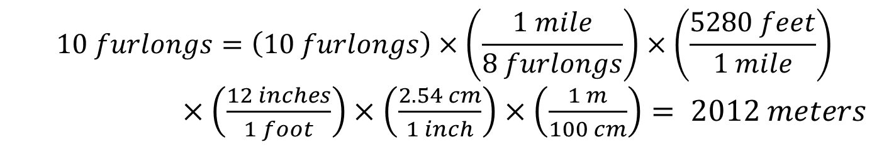
Unit conversions
Exactly ten furlongs is how many meters?
1 inch = 2.54 cm
100 cm = 1 m and 1000 m = 1 km
12 inches = 1 foot
5280 feet = 1 mile and 8 furlongs = 1 mile
$$10 furlongs=\left(10 furlongs\right)×\left(\frac{1 mile}{8 furlongs}\right)×\left(\frac{5280 feet}{1 mile}\right)$$ $×\left(\frac{12 inches}{1 foot}\right)×\left(\frac{2.54 cm}{1 inch}\right)×\left(\frac{1 m}{100 cm}\right)= 2012 meters$

Slide 13
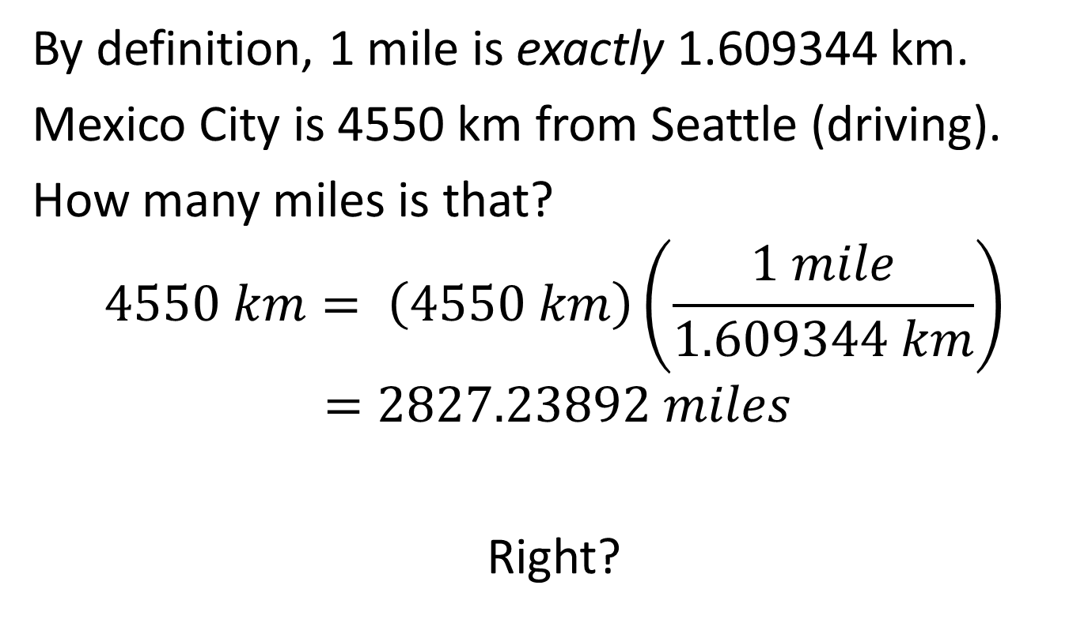
More unit conversions
By definition, 1 mile is exactly 1.609344 km.
Mexico City is 4550 km from Seattle (driving).
How many miles is that?
$$4550 km= \left(4550 km\right)\left(\frac{1 mile}{1.609344 km}\right) \\ =2827.23892 miles$$
Right?

Slide 14
Significant figures
We shouldn’t say Mexico City is 2827.23892 miles from Seattle. That suggests we know the distance to within a hundred thousandth of a mile (about a millimeter). We don’t.
The distance we know is 4550 km (within 10 km)
Our knowledge only has three significant figures.
So our answer should be no more accurate.
“2830 miles” is a better answer.

Slide 15
Pop quiz
How many sig figs in “1400 kg”?
How many sig figs in “14.00 kg”?
How many sig figs in “1400.0 kg”?
What is 3.1 cm × 4.3 cm?
13 cm (not 13.3 cm, not 13.33 cm)
What is 24.31 cm – 19.21 cm?
5.10 cm (not 5.1 cm)

Slide 16
Pop quiz 2
The Voyager I spacecraft is 18 billion km from the Sun. Light travels at a speed of 3 × 10⁸ m/s.
How long does it take light from the Sun to reach Voyager? Answer in minutes.
Radio signals move at the same speed as light. Assume the Earth is between Voyager and the Sun, a distance of 150 million km from the Sun.
How long does it take radio signals from Voyager to reach Earth? Answer in minutes.

Slide 17
Dimensional analysis
Simply knowing the units and dimensions of a physics problem tells a scientist a GREAT DEAL about the answer.
Quantities must be dimensionally consistent. If you want to know the mass of an object, the answer won’t have units of centimeters.
Just that much knowledge is powerful.

Slide 18
Dimensional Consistency
What is 30.0 feet minus 3.0 feet?
27.0 feet
What is 3.0 feet minus 3.0 inches?
36 inches – 3.0 inches = 33 inches
What is 3.0 feet minus 3.0 gallons?
Well???

Slide 19
Dimensional analysis
You are hired by a Hollywood stunt company to build a cushion for stunt men to land on after a fall. You don’t want the impact force to exceed 2000 lbs (8000 newtons). A 70 kg stuntman will hit the cushion at a speed of 20 m/s. 1 newton is the same as 1 kg m/s². Roughly how thick does the cushion need to be?
HUGE HINT: Your answer has to be a length.

Slide 20
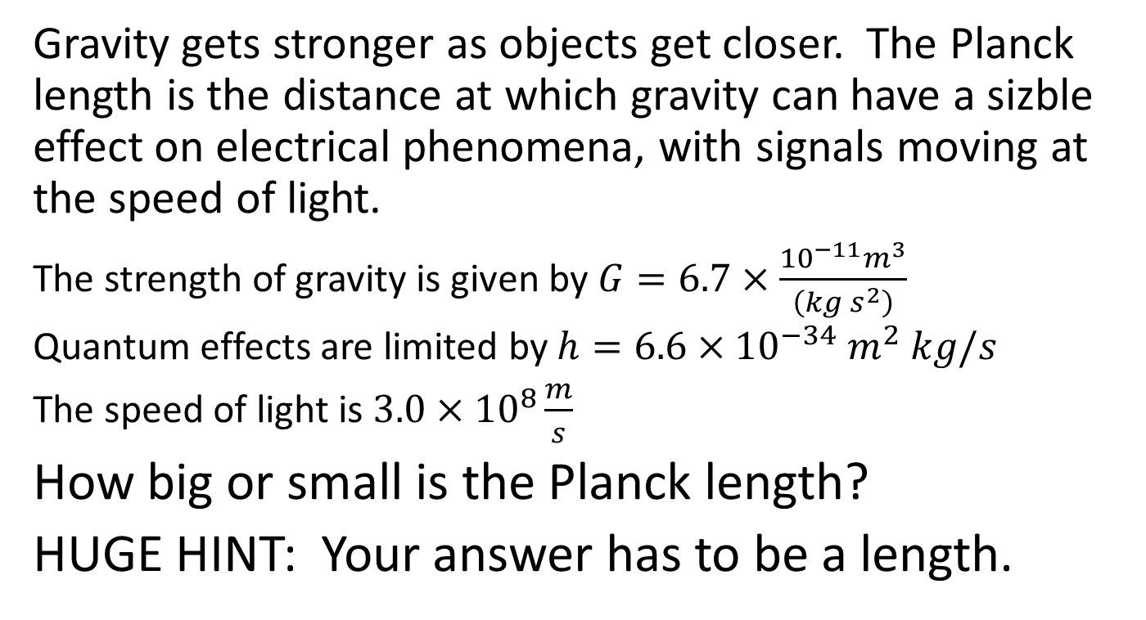
Dimensional analysis
Gravity gets stronger as objects get closer. The Planck length is the distance at which gravity can have a sizble effect on electrical phenomena, with signals moving at the speed of light.
The strength of gravity is given by $G=6.7×\frac{{10}^{−11}m^{3}}{\left(kg s^{2}\right)}$
Quantum effects are limited by $h=6.6×{10}^{−34}{ m}^{2} kg/s$
The speed of light is $3.0×{10}^{8}\frac{m}{s}$
How big or small is the Planck length?
HUGE HINT: Your answer has to be a length.

Slide 21
Dimensional analysis
Dimensional analysis is the single most powerful tool available to scientists and engineers.
Learn to use it.
And use it.

