Slide 1
Interference of waves from two sources
Hyperbolas and Asymptotes

Slide 2
Start with two sources of waves

Slide 3
Start with two sources of waves
The grid in the diagram shows the wavelength of a wave.
For example:
Separation distance = 10 m
Wavelength = 3 m

Slide 4
Start with two sources of waves
The grid in the diagram shows the wavelength of a wave.
For example:
Separation distance = 10 m
Wavelength = 3 m

Slide 5
Start with two sources of waves
Now add the second set of waves

Slide 6
Start with two sources of waves

Slide 7
Constructive interference
Find the locations of
constructive interference

Slide 8
Constructive interference

Slide 9
Destructive interference
Find the locations of
destructive interference

Slide 10
Destructive interference

Slide 11
Show both

Slide 12
Constructive and destructive interference

Slide 13
Constructive and destructive interference
The diagram is cluttered
To make the diagram more readable,
hide the waves
leave the lines of interference

Slide 14
Constructive and destructive interference

Slide 15
Constructive and destructive interference
To see more of the diagram,
Zoom out

Slide 16
Constructive and destructive interference

Slide 17
Constructive and destructive interference
The lines of constructive and destructive interference are hyperbolas.
Far from the sources, they look like straight lines (the asymptotes).
To clean up the diagram again, just look at the constructive interference.

Slide 18
Interference from two sources

Slide 19
Interference from two sources
The hyperbolas show the exact location of constructive interference.
Far from the sources, the hyperbolas look like straight lines (asymptotes).
How close are they to the asymptotes?

Slide 20
Interference from two sources

Slide 21
Interference from two sources
The asymptotes show locations of interference if:
The location is not between the sources, and
The distance from sources is more than a few wavelengths

Slide 22
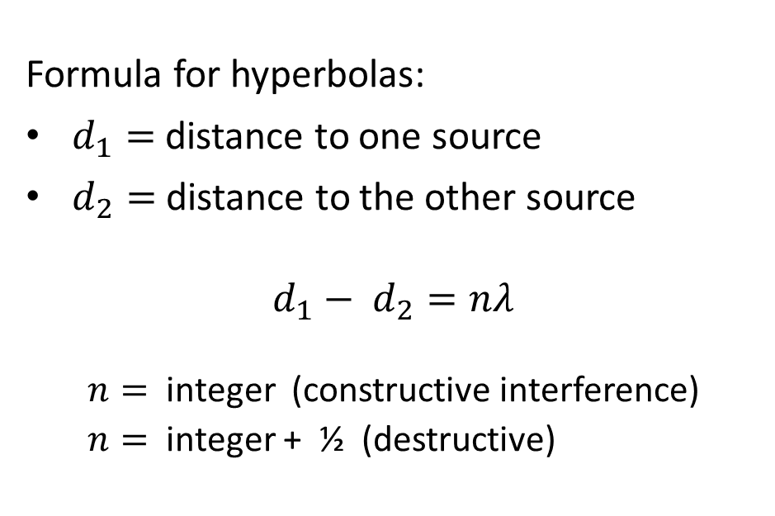
Interference from two sources
Formula for hyperbolas:
$d_{1}=$ distance to one source
$d_{2}=$ distance to the other source
$d_{1}− d_{2}=nλ$
$n=$ integer (constructive interference)
$n=$ integer + ½ (destructive)

Slide 23
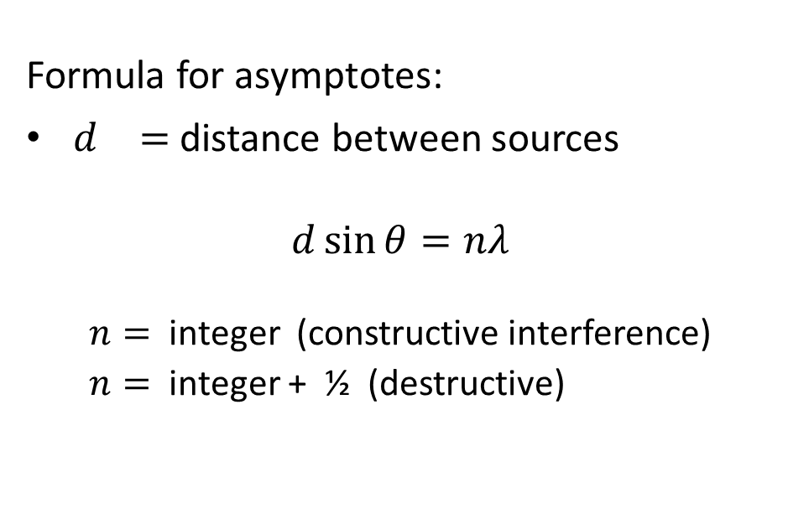
Interference from two sources
Formula for asymptotes:
$d_{}=$ distance between sources
$d\sin{θ}=nλ$
$n=$ integer (constructive interference)
$n=$ integer + ½ (destructive)
d
θ

Slide 24
Interference from two sources

Slide 25
Interference from two sources

