Slide 2

An irrational obsession and
The Electric Google
Application Test
ϕ
∞

Slide 3
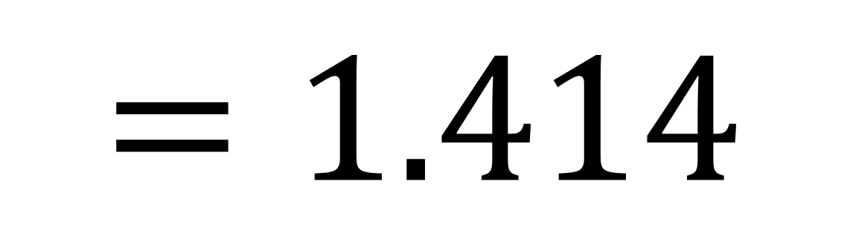

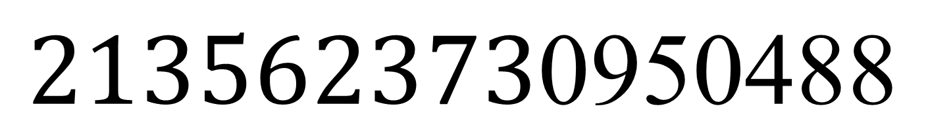
$$\sqrt{2}$$
$$=1.414$$
$$213562373\text{0950}\text{488}$$
$$01688724209698078569671875$$
$$37694807317667973799073247846210703885038753$$
$$43276415727350138462309122970249248360558507372126441214970999358314132226659$$
$$2750559275579995050115278206057147010955997160597027453459686201472851741864088\text{919860955232923048430871432145083976260362799525140799}$$
(dot dot dot)

Slide 4
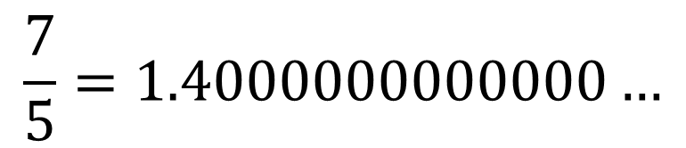

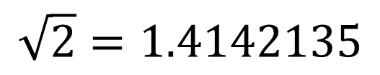
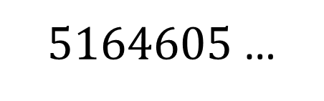
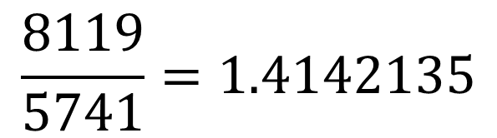
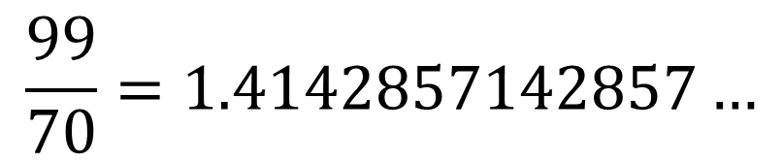
My obsession began:
$$\sqrt{2}=1.4142135$$
$$62373095 …$$
$$\frac{7}{5}=1.4000000000000…$$
$$\frac{99}{70}=1.4142857142857…$$
$$\frac{8119}{5741}=1.4142135$$
$5164605$ …

Slide 5

And then,
on my birthday,
September 27, 1998
this appeared…
Over $30 billion in profits in 2011
Electric circuits? Google?
Which is one of the reasons why it is interesting that
Google once offered a job interview to anyone who
could solve an electric circuit problem.
Chosen as the most desirable employer in America
The goal was to identify smart people.
So Google asked some “interesting” questions.

Slide 6
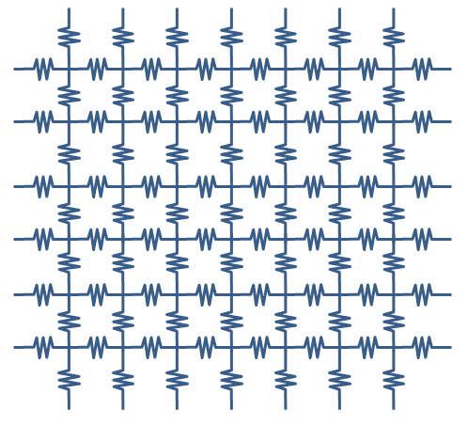

Imagine an electric circuit composed of an infinite number of 1-ohm resistors in a 2-dimensional grid.
$$=1 ohm$$

Slide 7
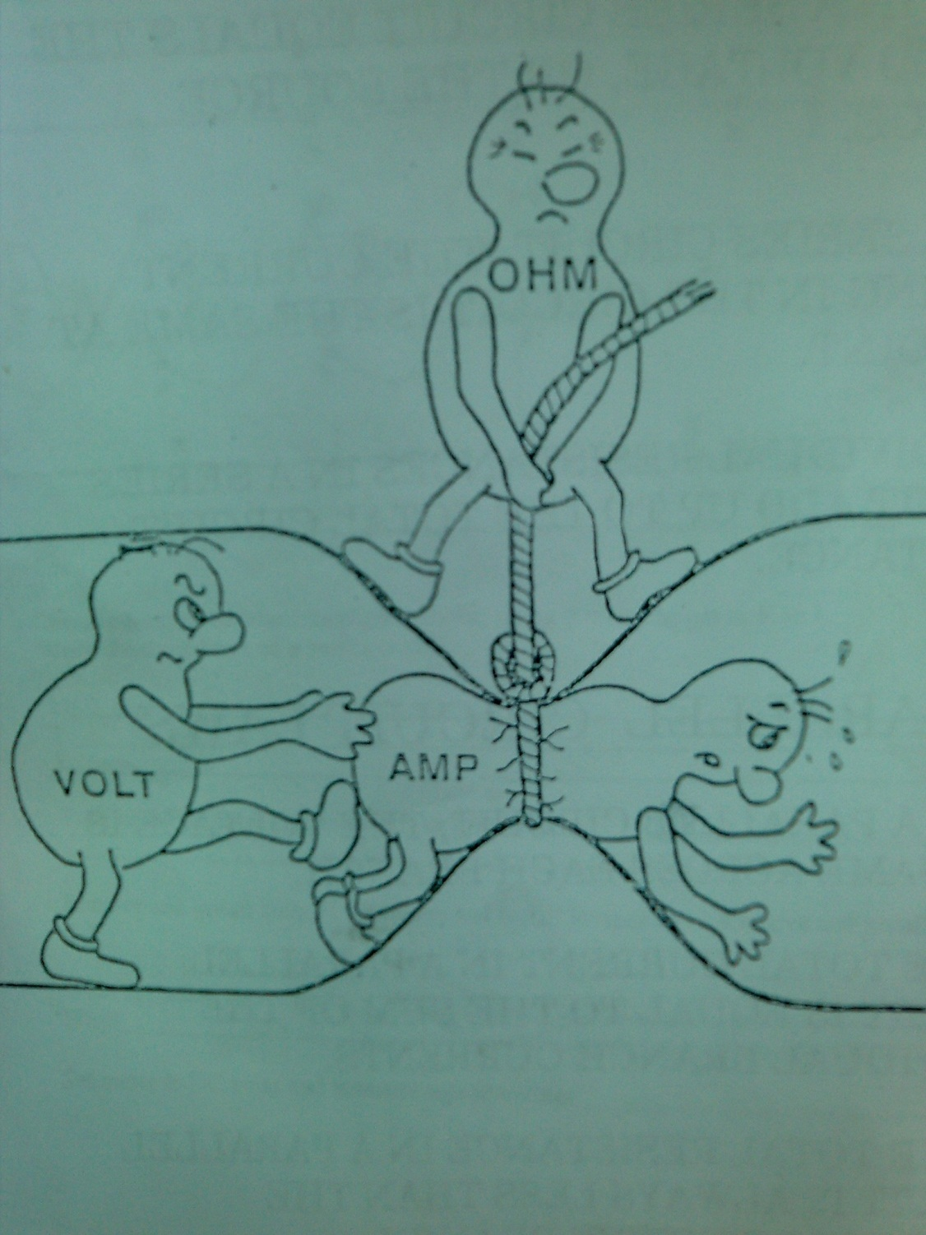
What really happens inside an electric circuit:

Slide 8
Imagine an electric circuit composed of an infinite number of 1-ohm resistors in a 2-dimensional grid.
$$=1 ohm$$
What is the total resistance between these two points?

Slide 9
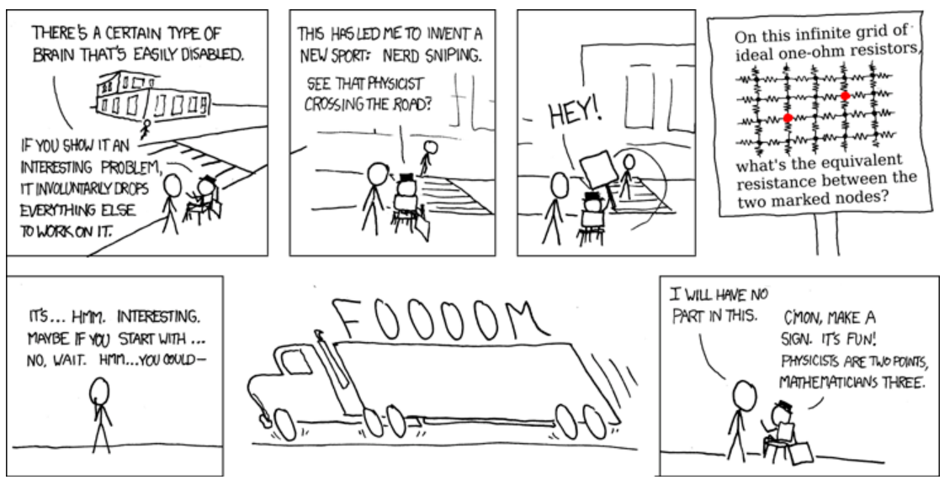
Notice that mathematicians’ brains are
more expensive than physicists’ brains
xkcd by Randall Munroe
(because physicists’ brains are used).

Slide 10
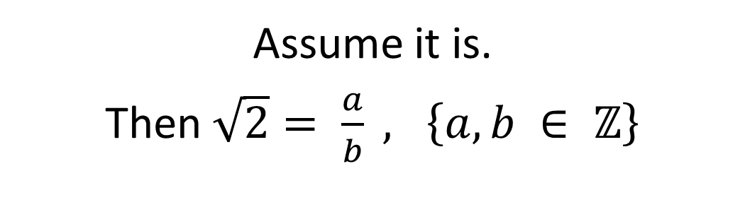


Is $\sqrt{2}$ rational?
And now back to $\sqrt{2}.$
Assume it is.
Then $\sqrt{2}= \frac{a}{b} , \left\{a, b ∈ ℤ\right\}$

Slide 11
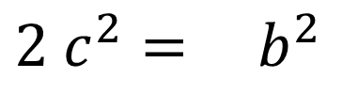

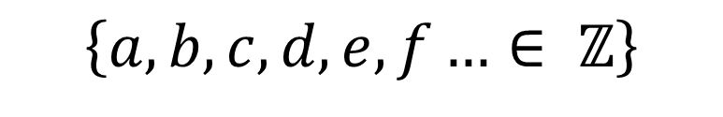



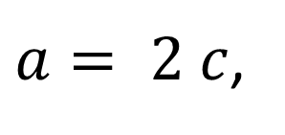
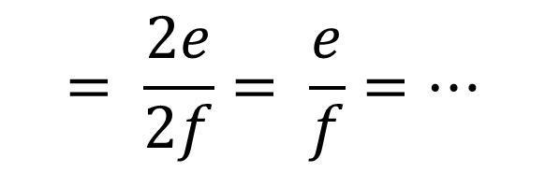

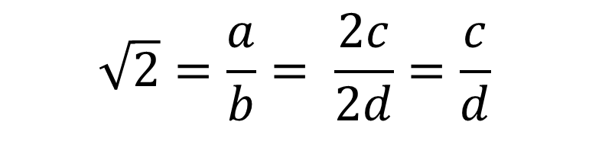
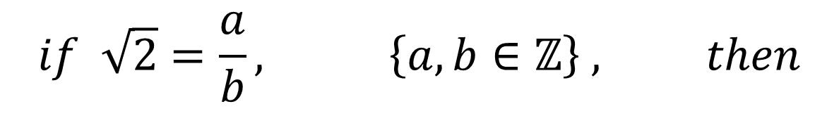
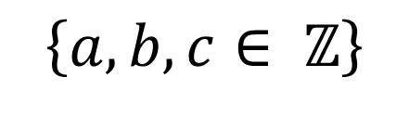

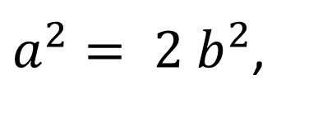
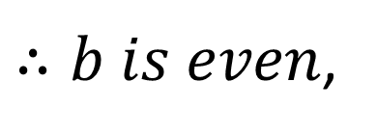
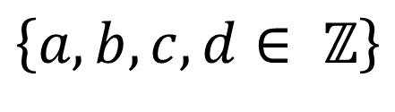
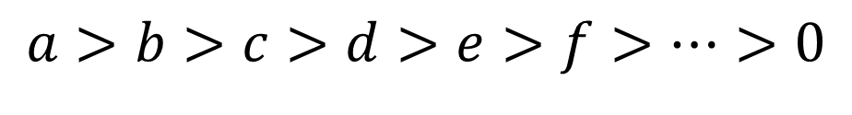

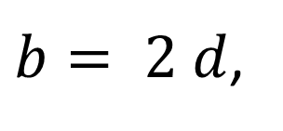

$$if \sqrt{2}=\frac{a}{b}, \left\{a,b∈ℤ\right\} , then$$
$\frac{a}{b}=\sqrt{2}$ ,
$\frac{a}{b}=\sqrt{2}$ ,
$$\left\{a,b ∈ ℤ\right\}$$
$$\left\{a, b ∈ ℤ\right\}$$
$$\sqrt{2}=\frac{a}{b}= \frac{2c}{2d}=\frac{c}{d}$$
$$= \frac{2e}{2f}= \frac{e}{f}=…$$
$\frac{a^{2}}{b^{2}}= 2$ ,
$a^{2}= 2 b^{2}$,
$$\left\{a, b, c,d,e,f…∈ ℤ\right\}$$
$∴a is even$,
$$\left\{a, b, c∈ ℤ\right\}$$
$a= 2 c$,
$$a>b>c>d>e>f>…>0$$
$$4 c^{2}$$
$2 c^{2}= { b}^{2}$
$$a^{2}$$
$=2 b^{2}$
$∴b is even$,
$$\left\{a, b, c,d∈ ℤ\right\}$$
$b= 2 d$,
$$∴\sqrt{2} is irrational.$$

Slide 12
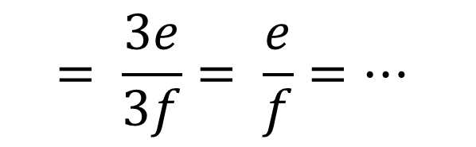

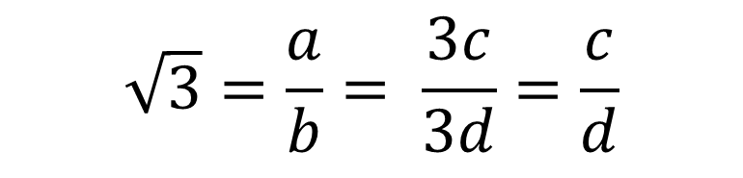
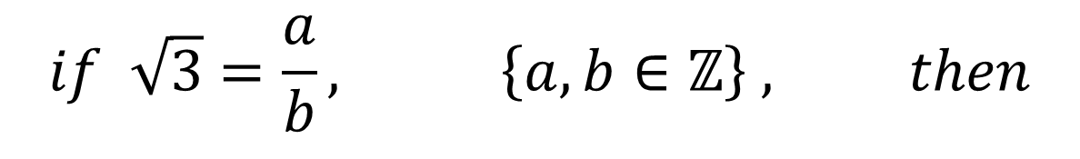
$$if \sqrt{3}=\frac{a}{b}, \left\{a,b∈ℤ\right\} , then$$
$$\sqrt{3}=\frac{a}{b}= \frac{3c}{3d}=\frac{c}{d}$$
$$= \frac{3e}{3f}= \frac{e}{f}=…$$
$$\left\{a, b, c,d,e,f…∈ ℤ\right\}$$
$$a>b>c>d>e>f>…>0$$
$$∴\sqrt{3} is irrational.$$

Slide 13
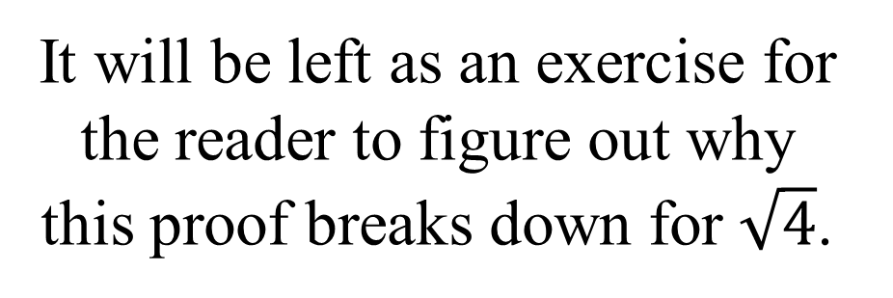
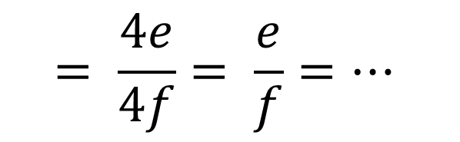

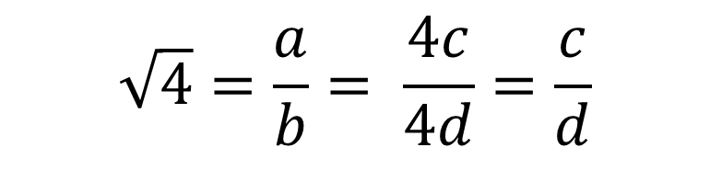
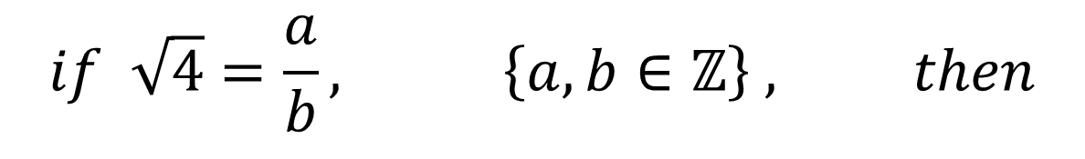
$$if \sqrt{4}=\frac{a}{b}, \left\{a,b∈ℤ\right\} , then$$
$$\sqrt{4}=\frac{a}{b}= \frac{4c}{4d}=\frac{c}{d}$$
$$= \frac{4e}{4f}= \frac{e}{f}=…$$
No.
$$\left\{a, b, c,d,e,f…∈ ℤ\right\}$$
It will be left as an exercise for the reader to figure out why this proof breaks down for $\sqrt{4}$.
$$a>b>c>d>e>f>…>0$$
$$∴\sqrt{4} is irrational ???$$

Slide 14









So there are no integers
$$\left\{a, b ∈ℤ\right\}$$
such that
$$a^{2}=2 b^{2}$$
The best we can hope for is
$$a^{2}=2 b^{2}±1$$
And there are plenty of these:
$$1^{2}=2 \left(0^{2}\right)+1$$
$$1^{2}=2 \left(1^{2}\right)−1$$
$$3^{2}=2 \left(2^{2}\right)+1$$
$$7^{2}=2 \left(5^{2}\right)−1$$
$${17}^{2}=2 \left({12}^{2}\right)+1$$
$${41}^{2}=2 \left({29}^{2}\right)−1$$

Slide 15
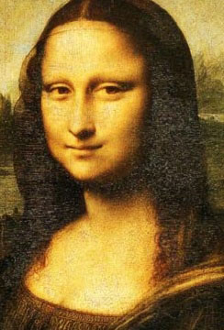
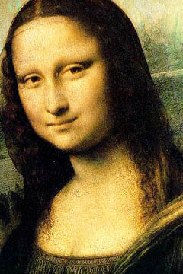


Could there be an infinite sequence of whole numbers
such that
?
$$\left\{a, b ∈ℤ\right\}$$
$$a^{2}=2 b^{2}±1$$
An infinite sequence of integers with ratios that
approximate an irrational number?
Really?
Really?

Slide 16
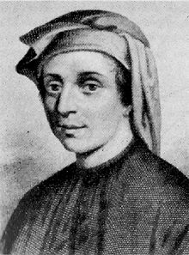

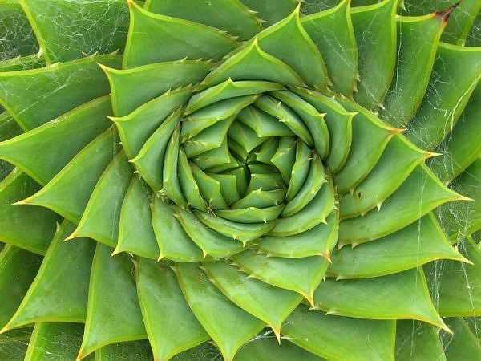
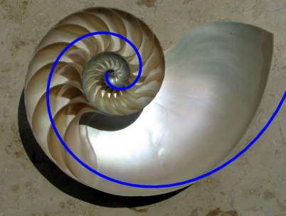






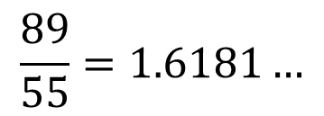




The Fibonacci Sequence
0, 1, 1, 2, 3, 5, 8, 13, 21, 34, 55, 89, 144, 233…
ϕ
$$F_{0}=0, F_{1}=1, F_{n+2}=F_{n+1}+F_{n}$$
$$=\frac{1}{2}\left(1+\sqrt{5}\right)$$
$$\frac{3}{2}=1.5$$
$$\frac{5}{3}=1.66…$$
∞
$$=1.618034…$$
$$\frac{8}{5}=1.6$$
$$\frac{13}{8}=1.625$$
$$\frac{21}{13}=1.615…$$
$$\frac{34}{21}=1.619…$$
$$\frac{55}{34}=1.6176…$$
$$\frac{89}{55}=1.6181…$$
$$\frac{F_{16}}{F_{15}}=1.618033…$$

Slide 17






The Golden Ratio: ϕ = 1.61803398874989…

Slide 18

The Golden Ratio: ϕ = 1.61803398874989…
$$φ≡\frac{1}{2}\left(1+\sqrt{5}\right)=\lim_{n→∞}\left(\frac{F_{n+1}}{F_{n}}\right)$$
$$F_{n+2}=F_{n+1}+F_{n} or F_{n+2}−F_{n+1}−F_{n}=0$$
Define the “next term” operator E:
For any term of a sequence S_{n} ,
E S_{n} = S_{n+1}
E² S_{n} = S_{n+2}
$$F_{n+2}−F_{n+1}−F_{n}=0 becomes {E^{2}F}_{n}−E F_{n}−F_{n}=0$$

Slide 19





We can factor this:
$${E^{2}F}_{n}−E F_{n}−F_{n}=0$$
$$\left(E^{2}−E−1\right)F_{n}=0$$
$$If E F_{n}=λ F_{n} , then λ^{2}−λ−1=0$$
$$λ_{±}=\frac{1}{2}\left(1±\sqrt{5}\right)$$
$$F_{n+2}−F_{n+1}−F_{n}=0 becomes {E^{2}F}_{n}−E F_{n}−F_{n}=0$$
$$λ_{+}=\frac{1}{2}\left(1+\sqrt{5}\right)=1.618…$$
$$λ_{−}=\frac{1}{2}\left(1−\sqrt{5}\right)=−0.618…$$

Slide 20




Just “a little” algebra shows that…
$$F_{n+1}=φ{ F}_{n}+{\left(−\frac{1}{φ}\right)}^{n}=φ{ F}_{n}+{\left(−0.618…\right)}^{n}$$
$$F_{n}=\frac{1}{\sqrt{5}}\left(φ^{n}−{\left[−\frac{1}{φ}\right]}^{n}\right)$$
Binet’s formula
$$λ_{+}=\frac{1}{2}\left(1+\sqrt{5}\right)=1.618…=φ$$
$$λ_{−}=\frac{1}{2}\left(1−\sqrt{5}\right)=−0.618…=−\frac{1}{φ}$$
(The proof will be left as an exercise for the reader.)

Slide 21











But what about $\sqrt{2 }$?
We’re looking for
$$\left\{a, b ∈ℤ\right\}$$
such that
$$a^{2}=2 b^{2}±1$$
$$1^{2}=2 \left(0^{2}\right)+1$$
$$a_{n}$$ | $$b_{n}$$ | $$a_{n}/b_{n}$$
1 | 0 | Undefined
1 | 1 | 1
3 | 2 | 1.5
7 | 5 | 1.4
17 | 12 | 1.4167
41 | 29 | 1.4138
99 | 70 | 1.4143
$$1^{2}=2 \left(1^{2}\right)−1$$
$$3^{2}=2 \left(2^{2}\right)+1$$
$$7^{2}=2 \left(5^{2}\right)−1$$
$${17}^{2}=2 \left({12}^{2}\right)+1$$
$${41}^{2}=2 \left({29}^{2}\right)−1$$
$${99}^{2}=2 \left({70}^{2}\right)+1$$

Slide 22







Notice:
$$a_{n+2}={2 a}_{n+1}+a_{n}$$
$$b_{n+2}={2 b}_{n+1}+b_{n}$$
$$If E a_{n}=λ a_{n} , then λ^{2}−2λ−1=0$$
$$λ_{−}=\left(1−\sqrt{2}\right)=\frac{−1}{1+\sqrt{2}}=−\frac{1}{λ_{+}}$$
$$λ_{±}=\left(1±\sqrt{2}\right)$$
$$a_{n}$$ | $$b_{n}$$ | $$a_{n}/b_{n}$$
1 | 0 | Undefined
1 | 1 | 1
3 | 2 | 1.5
7 | 5 | 1.4
17 | 12 | 1.4167
41 | 29 | 1.4138
99 | 70 | 1.4143
$$Let λ=\left(1+\sqrt{2}\right)$$
$$a_{n}=\frac{1}{2}\left(λ^{n}+{\left[−\frac{1}{λ}\right]}^{n}\right)$$
$$b_{n}=\frac{1}{2\sqrt{2}}\left(λ^{n}−{\left[−\frac{1}{λ}\right]}^{n}\right)$$

Slide 23










We have found an infinite number of pairs of positive integers
$$\left\{a_{n}, b_{n} ∈ℤ\right\}$$
such that
$$a_{n}≈\sqrt{2} b_{n}$$
, in fact…
$$a_{n+2}={2 a}_{n+1}+a_{n}$$
$$b_{n+2}={2 b}_{n+1}+b_{n}$$
$$a_{n}=\sqrt{2} b_{n}+{\left(−\frac{1}{λ}\right)}^{n}$$
$$a_{n}$$ | $$b_{n}$$ | $$a_{n}/b_{n}$$
1 | 1 | 1
3 | 2 | 1.5
7 | 5 | 1.4
17 | 12 | 1.4167
41 | 29 | 1.4138
99 | 70 | 1.4143
$$a_{n}$$ | $$b_{n}$$ | $$a_{n}/b_{n}$$
1 | 1 | 1
3 | 2 | 1.5
7 | 5 | 1.4
17 | 12 | 1.4167
41 | 29 | 1.4138
99 | 70 | 1.4143
239 | 169 | 1.41420
$$a_{n}$$ | $$b_{n}$$ | $$a_{n}/b_{n}$$
1 | 1 | 1
3 | 2 | 1.5
7 | 5 | 1.4
17 | 12 | 1.4167
41 | 29 | 1.4138
99 | 70 | 1.4143
239 | 169 | 1.41420
577 | 408 | 1.414216
$$a_{n}$$ | $$b_{n}$$ | $$a_{n}/b_{n}$$
1 | 1 | 1
3 | 2 | 1.5
7 | 5 | 1.4
17 | 12 | 1.4167
41 | 29 | 1.4138
99 | 70 | 1.4143
$$Let λ=\left(1+\sqrt{2}\right)$$
$$\left| \sqrt{2} −\frac{a_{n}}{b_{n}} \right|<\frac{1}{\left(2.414\right){ \left(b_{n}\right)}^{2}}$$
$$a_{n}=\frac{1}{2}\left(λ^{n}+{\left[−\frac{1}{λ}\right]}^{n}\right)$$
$$b_{n}=\frac{1}{2\sqrt{2}}\left(λ^{n}−{\left[−\frac{1}{λ}\right]}^{n}\right)$$

Slide 24


Hey… Doesn’t this have something to do with…
Hurwitz’ Theorem!
For any irrational number z there exists an infinite number of pairs of integers a, b, such that
$$\left| z−\frac{a_{n}}{b_{n}} \right|<\frac{1}{\sqrt{5}{ \left(b_{n}\right)}^{2}}$$
Adolf Hurwitz!

Slide 25







We have found an infinite number of pairs of positive integers
$$\left| \sqrt{2} −\frac{a_{n}}{b_{n}} \right|<\frac{1}{\left(2.414\right){ \left(b_{n}\right)}^{2}}$$
$$\left\{a_{n}, b_{n} ∈ℤ\right\}$$
such that
in fact…
we’ve found all of them!
Assume someone finds
$$\left\{a_{n}, b_{n} ∈ℤ\right\}$$
not on our list.
Define
$$a_{n−1}={2 b}_{n}−a_{n}$$
$$b_{n−1}=a_{n}−b_{n}$$
$If {\left(a_{n}\right)}^{2}−2$ ${\left(b_{n}\right)}^{2}=±1 then {\left(a_{n−1}\right)}^{2}−2 {\left(b_{n−1}\right)}^{2}=∓1$
Repeating this procedure will lead to
$$a_{1}=1,$$
and
$$b_{1}=1$$

Slide 26






There are two types of (real) irrational numbers
Algebraic
Transcendental
$$\sqrt{2}$$
$$π$$
For any irrational number z there exists an infinite number of pairs of integers a, b, such that
$$\frac{1}{2}\left(1+\sqrt{5}\right)$$
$$\ln{5}$$
$$3\sqrt{7}−\sqrt[5]{13}$$
$$\left| z−\frac{a_{n}}{b_{n}} \right|<\frac{1}{\sqrt{5}{ \left(b_{n}\right)}^{2}}$$
$$Arctan\left(7\right)$$
roots of finite
polynomials with
rational coefficients
roots of infinite
polynomials with
rational coefficients

Slide 27




Solve:
$$0=\frac{3}{2}−\frac{1}{2!}{ x}^{2}+\frac{1}{4!}{ x}^{4}$$
$$x=\sqrt{6}≈\frac{485}{198}$$
Solve:
$$0=\frac{3}{2}−\frac{1}{2!}{ x}^{2}+\frac{1}{4!}{ x}^{4}−\frac{1}{6!}x^{6}+\frac{1}{8!}x^{8}−\frac{1}{10!}x^{10}…$$
$$x=\frac{2π}{3}≈\frac{710}{339}$$

Slide 28
What does any of this have to do with the Google problem???
$$=1 ohm$$
What is the total resistance between these two points?

Slide 29
What really happens inside an electric circuit:

Slide 30



What is the total resistance between these two points?
Resistance
$$=1 ohm$$
What is the total resistance between these two points?
RESISTORS
IN SERIES:
$$=2 ohms$$
What is the total resistance between these two points?
$$=3 ohms$$
Resistances in series simply add

Slide 31








The opposite of resistance is conductance.
Conductances in parallel simply add
RESISTORS
IN PARALLEL:
$$conductance= \frac{1}{resistance}$$
$$\frac{1}{R_{TOTAL}}=\frac{1}{R_{1}}+\frac{1}{R_{2}}+ …$$
Conductance increases when resistors are added in parallel.
Conductance
Resistance
$$\frac{1}{1 ohm}$$
$$1 ohm$$
$$=\frac{1}{1 ohm}+\frac{1}{1 ohm}=\frac{2}{1 ohm}$$
$$\frac{1}{2} ohms$$
$$=\frac{1}{2 ohm}+\frac{1}{1 ohm}=\frac{3}{2 ohm}$$
$$\frac{2}{3} ohms$$

Slide 32






Try some harder ones...
0, 1, 1, 2, 3, 5, 8, 13, 21, 34, 55, 89, 144, 233…
$$=\left(1 ohm\right)+{\left(\frac{1}{1 ohm}+\frac{1}{\frac{13}{8} ohms}\right)}^{−1}=\frac{34}{21} ohms$$
$$=\left(1 ohm\right)+{\left(\frac{1}{1 ohm}+\frac{1}{\frac{5}{3} ohms}\right)}^{−1}=\frac{13}{8} ohms$$
$$=\left(1 ohm\right)+{\left(\frac{1}{1 ohm}+\frac{1}{2 ohms}\right)}^{−1}=\frac{5}{3} ohms$$
$$= 2 ohms=\frac{2}{1} ohms$$
$$="∞" ohms=\frac{1}{0} ohms$$

Slide 33





0, 1, 1, 2, 3, 5, 8, 13, 21, 34, 55, 89, 144, 233…
…
$$Total resistance of blue resistors=R ohms$$
$Total resistance of all resistors=R ohms$
$$R=\left(1\right)+{\left(\frac{1}{1}+\frac{1}{R}\right)}^{−1}=\frac{2 R+1}{R+1}$$
$$R^{2}= R +1$$
$$R+R^{2}=2 R+1$$
$$R=\frac{1}{2}\left(1+\sqrt{5}\right)=φ=1.61803…$$

Slide 34
…
…
$$Total resistance of all resistors=\sqrt{2} ohms$$
$$Total resistance of all resistors=φ ohms$$
ϕ
∞

Slide 35
…
…
$$Total resistance of all resistors=\sqrt{3} ohms$$
ϕ
∞

Slide 36

…
…
$$Total resistance between the red dots=\frac{1}{\sqrt{3}} ohms$$

Slide 37
But we still don’t know how to solve this!
$$=1 ohm$$
What is the total resistance between these two points?

Slide 38

Surprise!
Leo Lavatelli, American Journal of Physics,
Volume 40, pg 1248,
September 1972
“The Resistive Net and Finite-Difference Equations”

Slide 39

Surprise #2!
James Clerck Maxwell
1831 - 1879

Slide 40











Label the currents with indices to denote locations in the circuit.
$$I_{−1}$$
$$I_{0}$$
$$I_{1}$$
$$I_{2}$$
$$I_{3}$$
Kirchhoff’s loop rule:
$$I_{0}−4 I_{1}+I_{2}=0$$
$$I_{n}−4 I_{n+1}+I_{n+2}=0$$
$$Let E I_{n}=I_{n+1}$$
$$\left(1−4E+E^{2}\right)I_{n}=0$$
$$Eigenvalues: E I_{n}=λ{ I}_{n}$$
$$λ=2+\sqrt{3}$$

Slide 41








Particular solution:
$$I_{ext}$$
$$I_{−1}$$
$$I_{0}$$
$$I_{1}$$
$$I_{2}$$
$$I_{3}$$
$$For all n<0, { I}_{n}=\frac{1}{λ} I_{n+1}$$
$$For all n>1, { I}_{n}=\frac{1}{λ} I_{n−1}$$
$$I_{ext}−I_{0}+4 I_{1}−I_{2}=0$$
$$\left(I_{ext}−I_{0}+I_{1}\right)R=V$$
$$I_{0}=−I_{1} and I_{2}=\frac{1}{λ} I_{1}$$
$$λ=2+\sqrt{3}$$
$$R=\frac{1}{\sqrt{3}} ohms$$

Slide 42















This method generalizes to 2 dimensions!
$$I_{−1,1}$$
$$I_{0,1}$$
$$I_{1,1}$$
$$I_{2,1}$$
$$I_{3,1}$$
$$I_{−1,0}$$
$$I_{0,0}$$
$$I_{1,0}$$
$$I_{2,0}$$
$$I_{3,0}$$
$$I_{−1,−1}$$
$$I_{0,−1}$$
$$I_{1,−1}$$
$$I_{2,−1}$$
$$I_{3,−1}$$

Slide 43


This method generalizes to 2 dimensions!
$$E_{x} I_{m, n}=I_{m+1, n}$$
$$E_{y} I_{m, n}=I_{m, n+1}$$
Horizontal and vertical equations are inseparable.
Current loops influence each other in a nonlinear way.

Slide 44
Interactions of two current loops: 1D chain
A
B

Slide 45
Interactions of two current loops: 2D array
A
B

Slide 46
Complexity of solutions of 2D grids
Number of rows Order of polynomials Number of equations
1
2
1
Fortunately the infinite dimensional 2D grid
is “simpler” than a grid with 20 infinite rows.
2
4
2
3
6
6
But a full solution involves multivariate calculus
and the creation of appropriate Green’s functions.
7
14
924
20
40
35 billion

Slide 47



$$=1 ohm$$
What is the total resistance between these two points?
Finite element:
$$1 ohm$$
Infinite 1-D chain:
$$\frac{1}{\sqrt{3}} ohms$$
Infinite 2-D array:
$$\frac{1}{2} ohms$$

Slide 48



$$=1 ohm$$
What is the total resistance between these two points?
Finite element:
$$1 ohm$$
Infinite 1-D chain:
$$\frac{\sqrt{3}}{2} ohms$$
Infinite 2-D array:
$$\frac{2}{π} ohms$$

Slide 49


$$=1 ohm$$
What is the total resistance between these two points?
Finite element:
$$\frac{7}{5} ohm$$
Infinite 1-D chain:
$$\left(\frac{4}{\sqrt{3}}−1\right) ohms$$
Infinite 2-D array:

Slide 50

We are officially out of time.
It will be left as an exercise for the reader to find the resistance for an infinite 2D array.
All of the information you need is in the references, which are right here…

Slide 51
References:
Lavatelli, L., “The Resistive Net and Finite-Difference Equations,” American Journal of Physics, Volume 40, pg 1248,
Gardner, M., “The Calculus of Finite Differences,” reprinted in The Colossal Book of Mathematics, Norton & Co., 2001
Levine, L., “The Calculus of Finite Differences,” http://www.math.cornell.edu/~levine , Jan 2009
MathPages.com, “Infinite Grid of Resistors,” http://mathpages.com/home/kmath668/kmath668.htm
Munroe, R., xkcd.com
September, 1972

Slide 52




