Slide 1
Nuclei, Protons, & Quarks

Slide 2
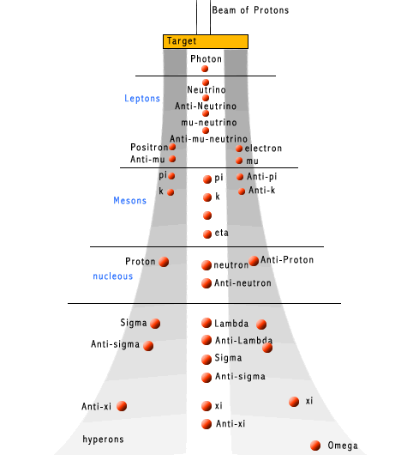
“Particles” known by late 1960s
Over 30 particles were known.
Thousands more are known now.

Slide 3
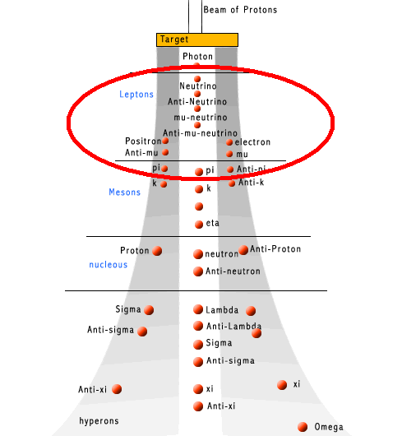
“Particles” known by late 1960s
These ones are “leptons”.
They don’t seem to have smaller parts.
Only 2 more have been discovered.

Slide 4
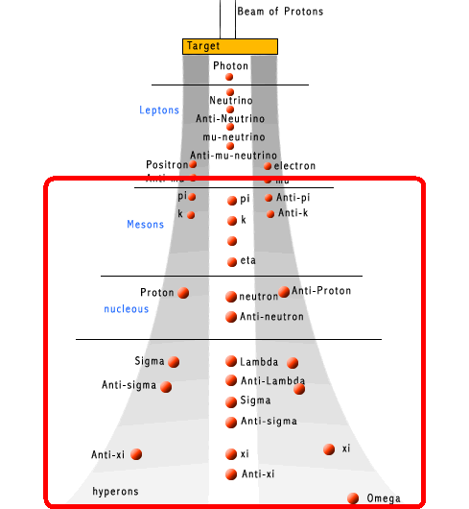
“Particles” known by late 1960s
These ones are “hadrons”.
Thousands more are known.
Could there be a pattern here?

Slide 5
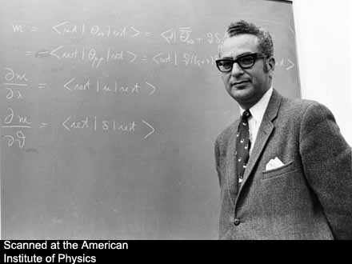
Murray Gell-Mann, 1969

Slide 6
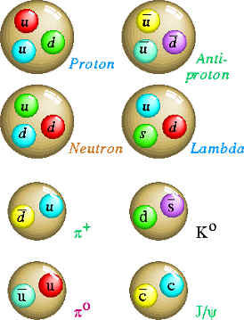
All the hadrons…
All hadrons known in 1970s could be explained as though “built” from 3 kinds of quarks.
The thousands of hadrons known today require only 6 quark “building blocks.”

Slide 7
We smash protons together

Slide 8
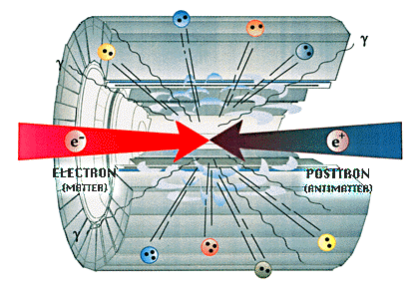
Or we smash other things together

Slide 9
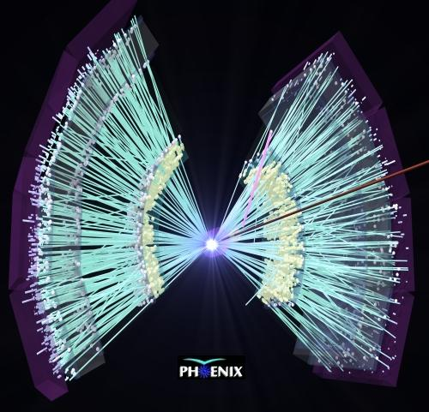
Stuff flies out in every direction

Slide 10
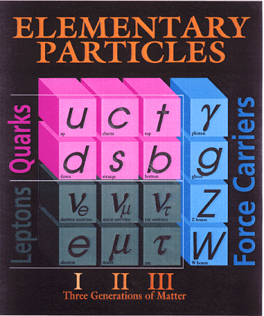
All of it can be explained by
Six quarks
Six leptons
& four “force carriers”

Slide 11
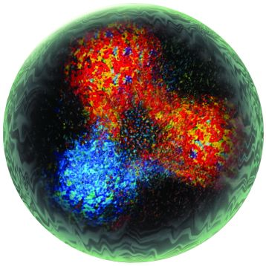
But we never see a quark by itself.

Slide 12
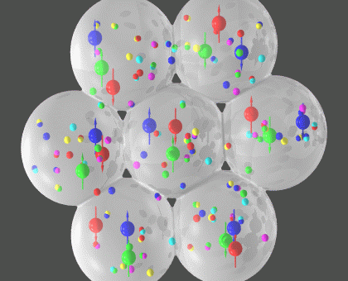
Quarks “hide” in hadrons in nuclei.

Slide 13
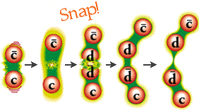
Try to knock some loose and…
They always make partners for themselves

Slide 14
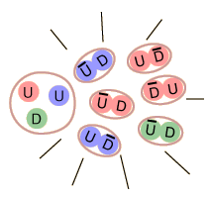
We say quarks are “confined”

Slide 15
Three models:
Quarks don’t exist. Gell-Mann just got lucky.
Hadrons are really “built out of” them. If we keep hitting harder, we’ll knock some loose.
They exist but knocking them loose is completely impossible.
All experimental tests have supported model #3.

Slide 16
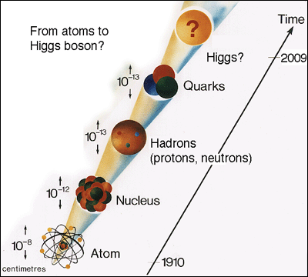
Now we study this model...

