Slide 1
Green River Physics
Hiring request: Fall 2019

Slide 2
Green River Physics
Completely different - Quality and quantity
Recent history - the Life of Brian
Where have all the adjuncts gone?
Quantum supremacy and the end of civilization

Slide 3
Quality
2000: Marv Nelson, the outstanding undergrad instructor in US
2005: One of 10 exemplary TYC physics programs
2006 – 2019: Most honored chapter of Soc. of Physics Students
2006 – 2019: Keith, Ajay, Chitra, & Adrienne hold regional and/or national leadership positions (AIP, AAPT, PNACP)
2012 – 2019: Chitra Solomonson leads nationally recognized undergraduate research project (with LSAMP on the way)

Slide 4
Quality and quantity: under-represented populations?
Conceptual physics mirrors college population
Algebra-based physics is pretty close, too
Physics for scientists and engineers: White and Asian man’s world

Slide 5
Quality and quantity: under-represented populations?
Calc-based physics at GRC, Fall 2019
 | GRC Physics 221, 222, 223 | (Northern) National average
Women | 23% | 20%
Black/African-American | 7% | 2.5%
Latinx | 7% | 3%
Blk/Af-Am women | 2% | < 1%
Latina | 2.5% | < 1%

Slide 6
Quantity in general
Why do we have so many physics teachers?

Slide 7
Quantity in general
Lotsa students

Slide 8
Quantity in general
Classes are full

Slide 9
Quantity

Slide 10
Quantity

Slide 11
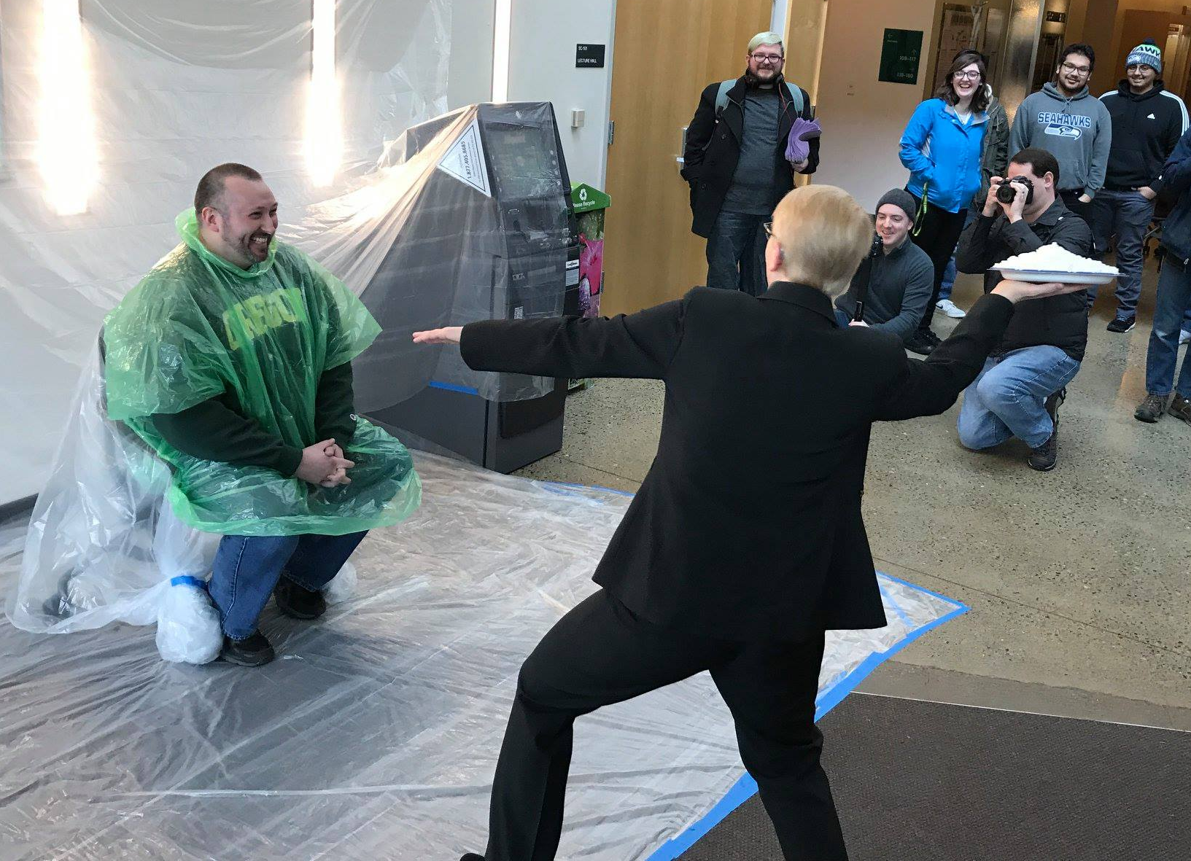
Recent history: the Life of Brian
Brian Stubbs
2005: Brian hired as an adjunct
2016: GRC needed new FT teacher
2017: Brian started tenure process
This has not worked out.
To meet the need, we tried to fill Brian’s previous load with new adjunct faculty.

Slide 12
Where have all the adjuncts gone?
Hiring of physicists by private tech firms increased by 88% from 2009 to 2015

Slide 13
Where have all the adjuncts gone?
Nationwide demand and supply of college physics teachers

Slide 14
Where have all the adjuncts gone?
Local (GRC) demand and supply of college physics teachers

Slide 15
Recent history: the Life of Brian
FT/Adjunct Ratios
Brian Stubbs hired
Down 1 FT
instructor
Keith Clay on leave

Slide 16
Recent history: the Life of Brian
In the past ten years:
We’ve interviewed 17 adjuncts
We’ve hired 9
Seven left within two quarters (one more left in 2014)
None new in past three years (no replacements for Brian)
Antonia BG retired last year (essentially 1 full-time lost)
Chitra’s research project is instructor-intensive
We are on a collision course with an iceberg spring quarter

Slide 17
Quantum supremacy & the end of civilization
October 2019:
Google claims their quantum computer is a BILLION TIMES faster than IBM’s fastest super computer
Also October 2019:
IBM scientists say, “No, it isn’t!” “It is only a THOUSAND TIMES faster.”

Slide 18
Quantum supremacy & the end of civilization
Soon programmers will need to know things like
and they don’t.
(so the applicant pool for adjuncts is unlikely to improve)

Slide 19
Questions?

