Slide 1
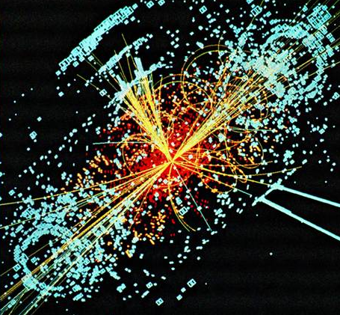
Quantum Mechanics and the Higgs Boson
A history of modern physics
From 1901 to next week.
Computer generated simulation of a Higgs
decay from the CMS detector at the LHC.

Slide 2
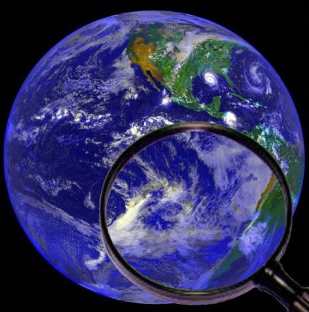
The nature of science
Prediction
Experiment
Mental Model
Idea
Observation

Slide 3
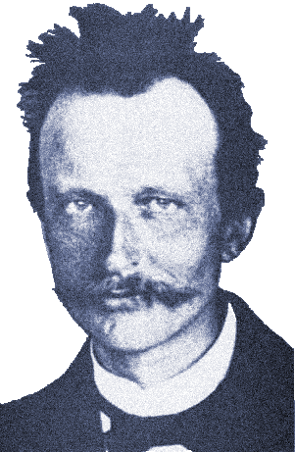
Quantum Theory Begins
Light has some of the properties of particles.
And I should care because…why?
Max Planck (1901)

Slide 4

Waves and Particles
One particle…
… plus another particle …
… equals two particles.

Slide 5
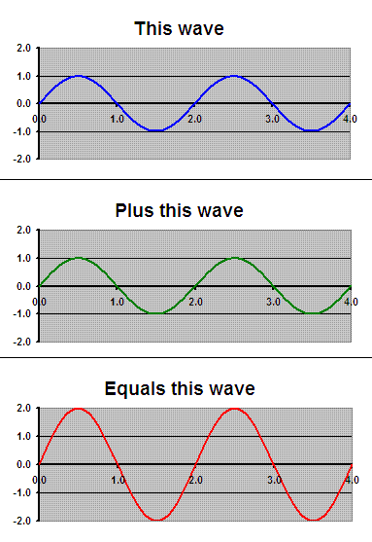
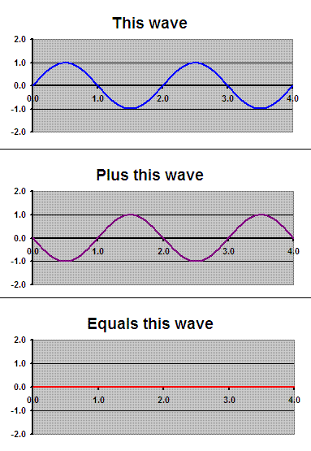
Waves and Particles
One wave plus another wave equals ???

Slide 6
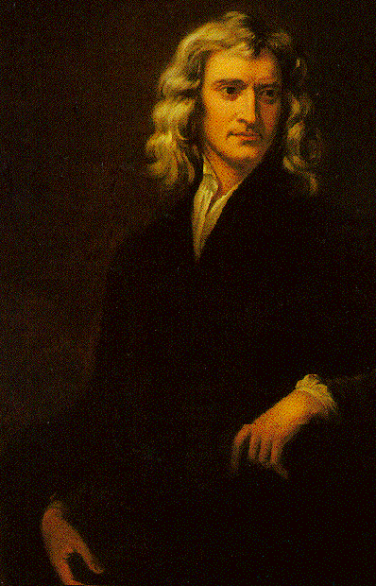
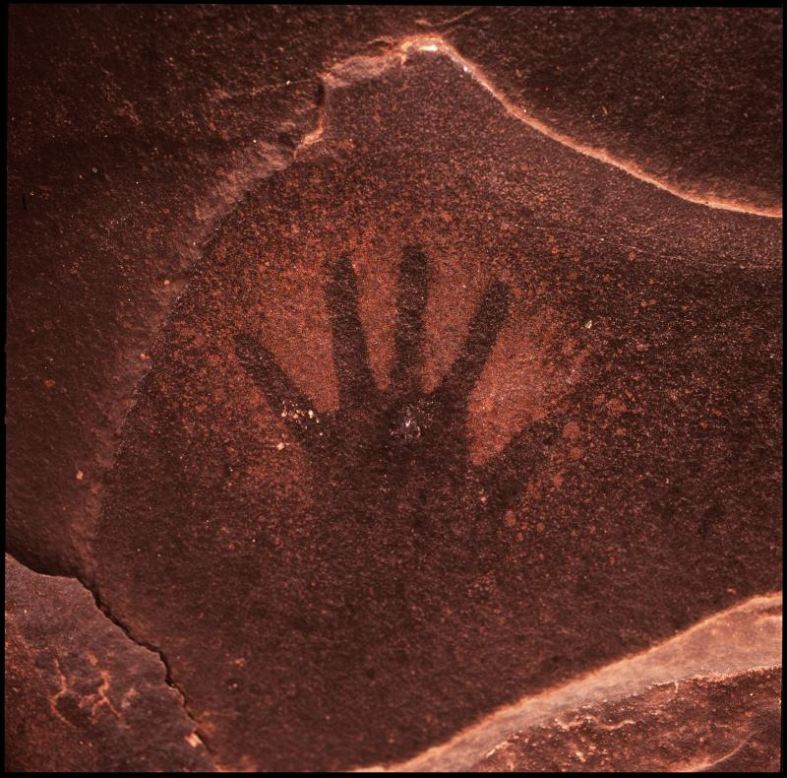
Waves or particles?
Light is composed
of particles.
Isaac Newton (1675)

Slide 7
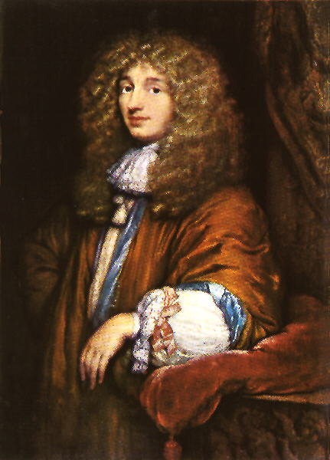
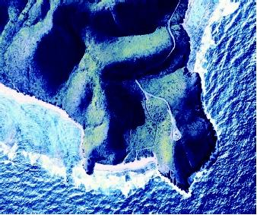
Waves or particles?
Light is composed
of waves.
Christian Huygens (1678)

Slide 8
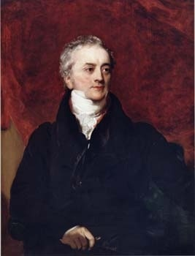
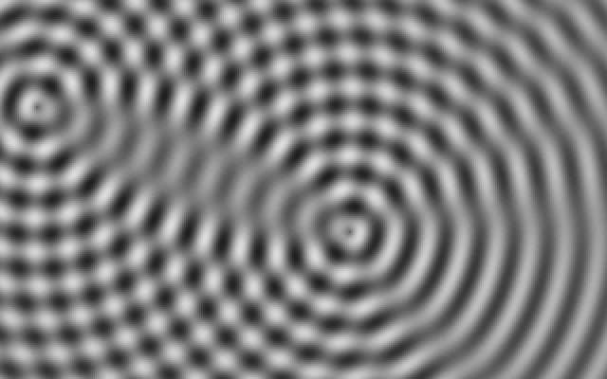
Waves or particles?
Huygens was right.
Light is a wave.
Thomas Young (1799)

Slide 9
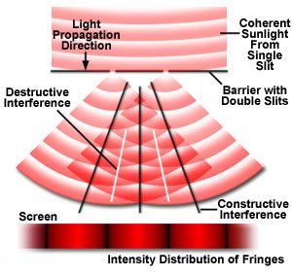
Young’s Double Slit Experiment

Slide 10
Young’s Double Slit Experiment
Computer simulations by U of Colorado PhET:
Demonstration with light, etc.:
http://phet.colorado.edu/new/simulations/sims.php?sim=Quantum_Wave_Interference

Slide 11
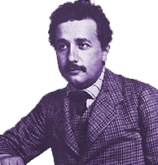
Quantum Theory Begins
Light has some of the properties of particles.
But if Young was right,
that means light has properties of particles AND properties of waves.
Yep.
Max Planck (1901)
Albert Einstein (1905)

Slide 12
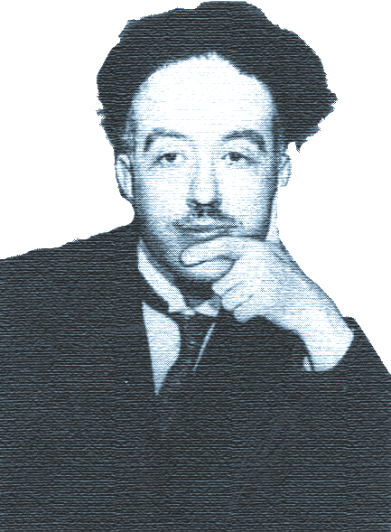
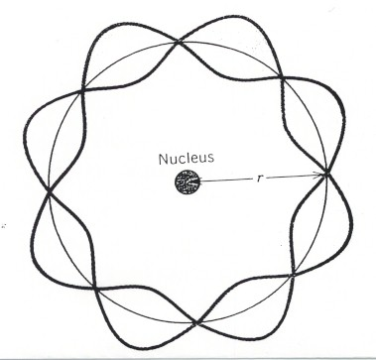
Waves or particles?
Atoms and electrons have some properties of waves.
Louis de Broglie (1924)

Slide 13
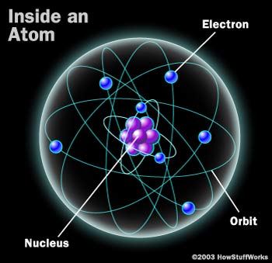
Map of the atom

Slide 14
Waves or particles?
Atoms and electrons have some properties of waves.
Louis de Broglie (1924)

Slide 15
Waves or particles?
A particle is somewhere.
Look! There it is!
A wave is sort of everywhere.
Look! There it is!

Slide 16
Waves or particles?
A wave has a sort of an influence
in many places at once.
We sometimes call something
like that a field.
Look! There it is!

Slide 17

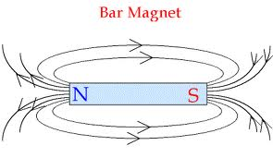
Waves or particles?
We sometimes call something
like that a field.

Slide 18
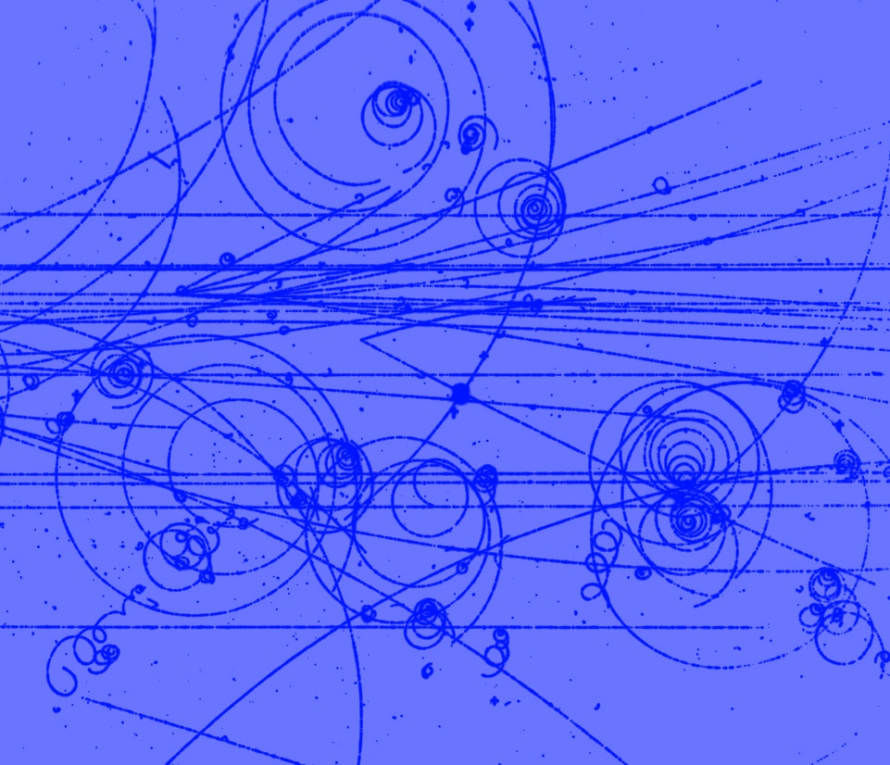
Waves or particles?
The magnetic field is everywhere
Electrically charged particles
moving through a magnetic field.

Slide 19
Waves or particles?
But fields are made
out of “particles”, too.

Slide 20
Waves or particles?
Particles acting like fields do not. They just push the other particles
Particles acting like particles leave tracks

Slide 21
Waves or particles?
If we shrink a wave down to the size of a particle…
So what does it mean for something
to be a wave and a particle?
… it’s not a wave anymore.
Wave.
Not a wave.
Not a wave.

Slide 22
Wave + Particle = “Quantum”
But what does a “wave-particle”
or “quantum” do?
Back to the University of Colorado:
http://phet.colorado.edu/new/simulations/sims.php?sim=Quantum_Wave_Interference

Slide 23
Wave + Particle = “Quantum”
If you don’t know which slit a particle went through…
…it will act like a wave that went through both…
… and interfere with itself.

Slide 24
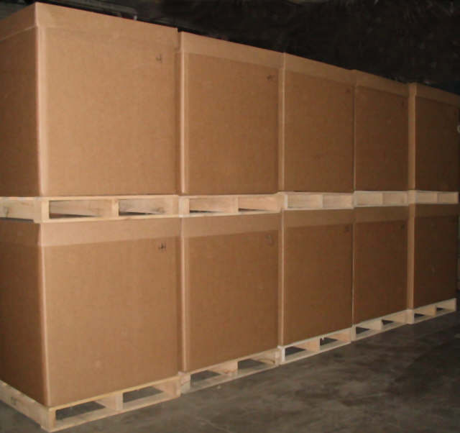
Wave + Particle = “Quantum”
Alternate experiment:
Build a bunch of “boxes”
Trap the particle in one of them
…without knowing which one.
Release the particle
It should interfere with
itself like a bunch
of waves that came
from each box.

Slide 25
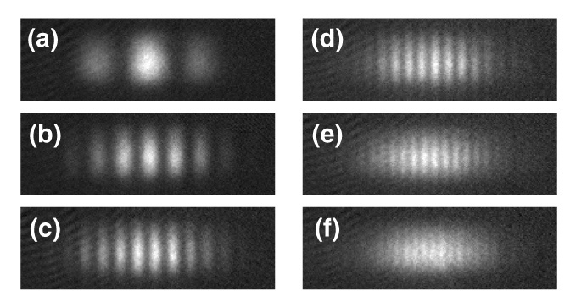
Wave + Particle = “Quantum”
Actual photos of atoms released
from Ramsey traps.

Slide 26
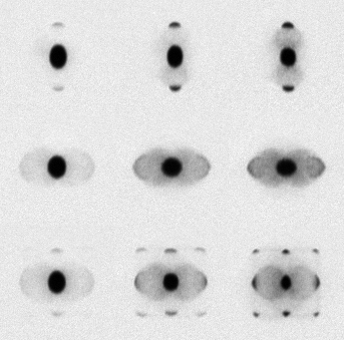
Wave + Particle = “Quantum”
Photos of atoms interfering after release from a two dimensional grid of slits.

Slide 27

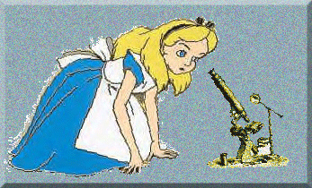
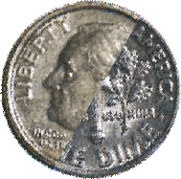
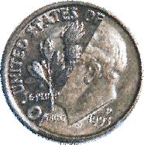
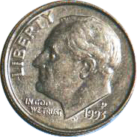
Mysteries of Quantum Mechanics
Before observation, only “mixtures of probability” exist. Physical properties (to be measured) are undefined.
“Observer”
“Observation”, “measurement”, or “experiment” occurs.
After observation, measured physical properties are defined.

Slide 28
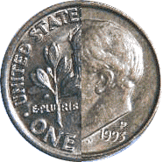
Mysteries of Quantum Mechanics
How can a coin be a “superposition” of heads and tails?
How does it “snap” into one state or the other upon observation?

Slide 29
So maybe it’s all wrong?
1940:
Quantum Mechanics
+ Electromagnetic Fields
= Quantum Field Theory

Slide 30
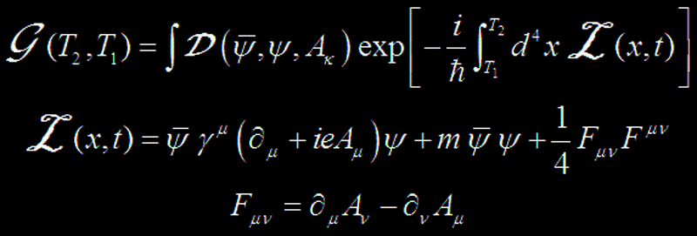
Quantum Field Theory
Quantum Electrodynamics

Slide 31
Quantum Field Theory
Quantum Electrodynamics:
The magnetic moment of an electron is…
Theory:
1.00115965214 ± 0.00000000004
Experiment:
1.001159652181 ± 0.000000000001
Quantum Electrodynamics
The magnetic moment of an electron is…
Theory:
1.0011596521
Experiment:
1.0011596521

Slide 32
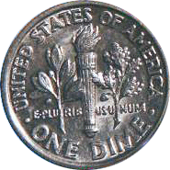
Quantum Field Theory
Theory: 1.00115965214 ± 0.00000000004
How accurate is that?

Slide 33
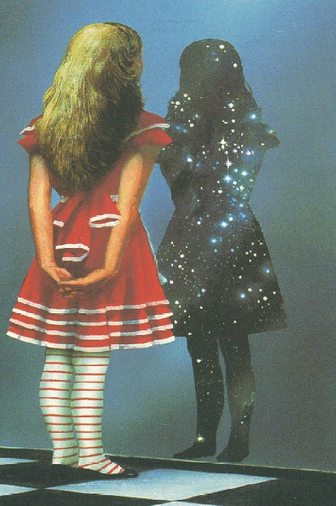
Through the looking glass:
Quantum Physics and Common Sense
Common sense is the collection of prejudices acquired by age eighteen.
Albert Einstien

Slide 34
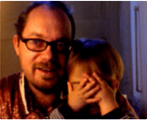
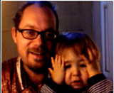
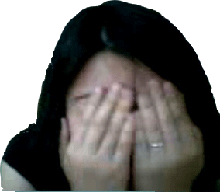
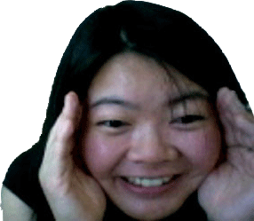
Common Sense & Peek-A-Boo

Slide 35
Peek-A-Boo Logic
Object Permanence:
“Mommy comes back”
Things that disappear
from sight are still there.
20

Slide 36
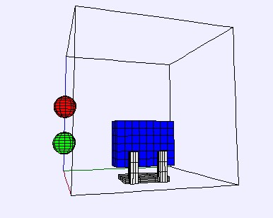
The Peek-A-Boo Principle
Watch this experiment.

Slide 37
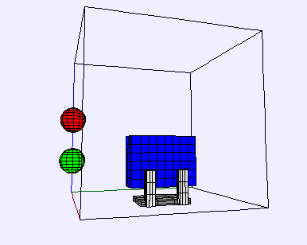
The Peek-A-Boo Principle
Watch this experiment.

Slide 38
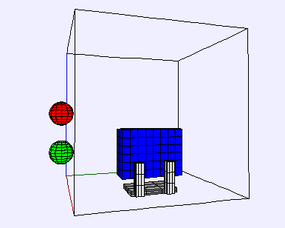
The Peek-A-Boo Principle
What happened?
Was it this?

Slide 39
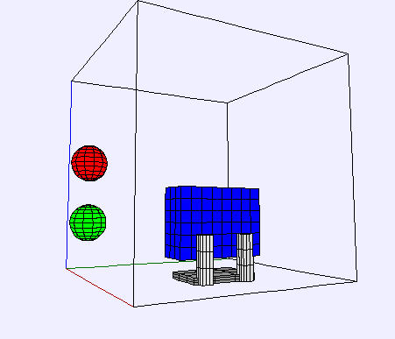
The Peek-A-Boo Principle
What happened?
Was it this?

Slide 40
The Peek-A-Boo Principle
Or was it this??

Slide 41
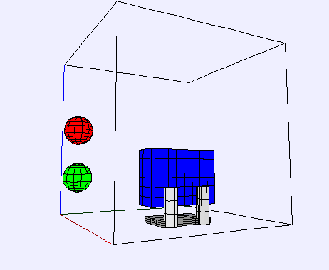
The Peek-A-Boo Principle
Or was it this??

Slide 42
The Peek-A-Boo Principle
Or was it this???

Slide 43
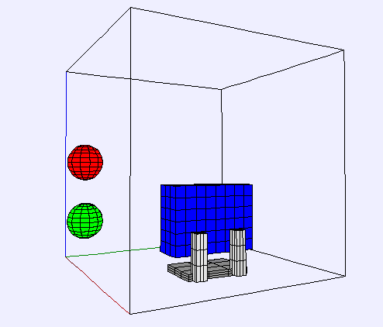
The Peek-A-Boo Principle
Or was it this???

Slide 44
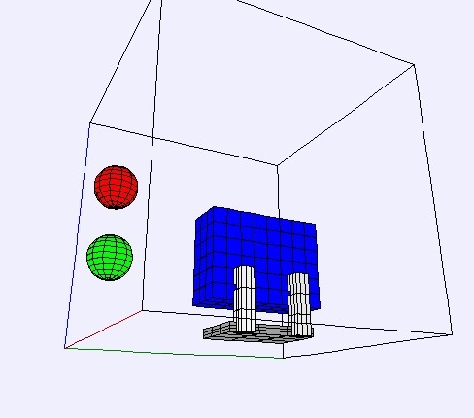
The Peek-A-Boo Principle
The only way
for science
to answer the
question is to
repeat the
experiment…

Slide 45

The Peek-A-Boo Principle
The only way
for science
to answer the
question is to
repeat the
experiment…

Slide 46
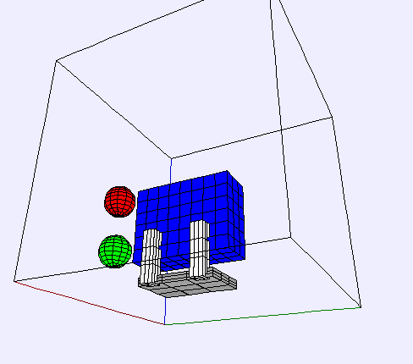
The Peek-A-Boo Principle
…and repeat
it again…

Slide 47
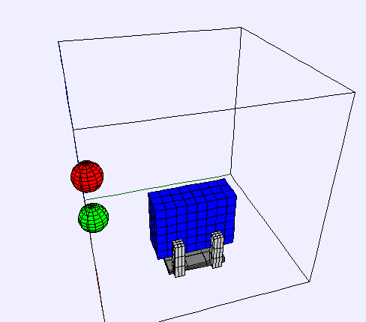
The Peek-A-Boo Principle
…and again.

Slide 48
Peek-A-Boo Logic
Scientific inquiry does not allow us to assume the nature of phenomena that
are not observed.

Slide 49
Peek-A-Boo Logic
Scientific inquiry does not allow us to assume the nature of phenomena that
are not observed.
Peek-A-Boo relies on assumptions
about things we cannot see.
When dealing with quantum mechanics
things unseen are not what they seem.

Slide 50
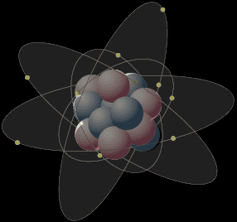
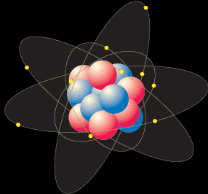
Peek-A-Boo and Q. Mechanics
A radioactive atom “decays” when it emits radiation.
The leftover atom is physically changed.

Slide 51
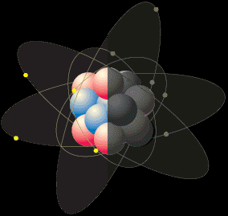
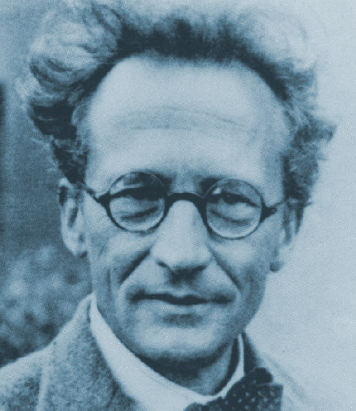
Peek-A-Boo and Q. Mechanics
A superposition of “decayed” and
“un-decayed” states.
What if we put the atom in a box without an observer?
When it is in a box, I can’t tell whether it has decayed or not.
It hasn’t been observed, so “Copenhagen” says it exists in a superposition state.
Erwin Schrödinger (1935)

Slide 52

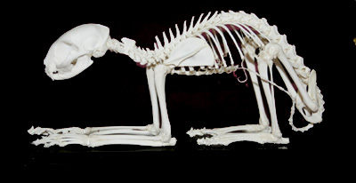
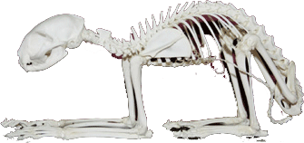
Peek-A-Boo and Copenhagen
Problem: If the cat hasn’t been observed, then isn’t the cat also in a superposition state of dead and alive?
How can a cat be
half dead?
Now add one cat.
Erwin Schrödinger (1935)

Slide 53


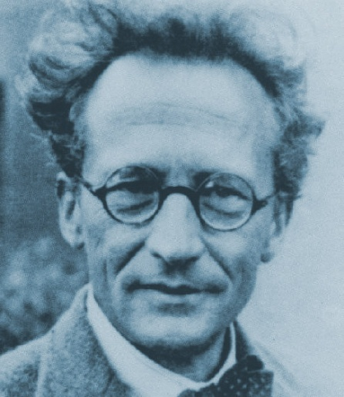

Famous Cats in Pop Culture
“Schröddy”
30

Slide 54

Common Sense and Fingerprints

Slide 55
The Myth of Fingerprints:
Distinguishability
Objects are different and we can distinguish them.
I recognize my mom.

Slide 56
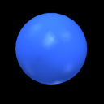




Fingerprints and Physics
All electrons are alike.
All protons are alike.
But completely indistinguishable.
Even THEY can’t tell them apart.
Not just similar as with identical twins.

Slide 57

Fingerprints and Physics
All electrons are alike.
All protons are alike.
Evidence!

Slide 58

The Mandel Experiment
Distinguished
photons
Leonard Mandel (1995)

Slide 59

The Mandel Experiment
Shoot identical photons (or electrons) through two slits. Will we get…
INTERFERENCE
OR
NO INTERFERENCE?

Slide 60

The Mandel Experiment
Now block Left slit. Photons only go through Right slit. Will we get…
INTERFERENCE
OR
NO INTERFERENCE?

Slide 61

The Mandel Experiment
Shoot distinguishable photons from two lasers. Will we get…
INTERFERENCE
OR
NO INTERFERENCE?

Slide 62

The Mandel Experiment
Shoot identical photons but put a detector over one slit. Will we get…
INTERFERENCE
OR
NO INTERFERENCE?

Slide 63
The Mandel Experiment
Same experiment, but turn the detector OFF (no human observer). Will we get…
INTERFERENCE
!!!
OR
NO INTERFERENCE?

Slide 64
The Mandel Experiment
Human observation is not necessary for quantum measurement effects!
The issue is not whether or not humans have information from a measurement.
The issue is whether or not the information exists!

Slide 65

Mandel and Schrödinger’s Cat
Schrodinger does not need
to observe the cat for it to be
definitely dead or definitely alive.
The presence of the cat is enough!
Thanks to Mandel,
the paradox of Schrodinger’s cat is …
Erwin Schrödinger (1935)

Slide 66
Mandel and Schrödinger’s Cat
Thanks to Mandel,
the paradox of Schrodinger’s cat is GONE!
Erwin Schrödinger (1935)

Slide 67

Mandel and Schrödinger’s Cat
You saw that coming,
Didn’t you?
The smile of Schrödinger’s cat:
What does it mean for
information to “exist”?
Thanks to Mandel,
the paradox of Schrodinger’s cat is GONE!
Erwin Schrödinger (1935)

Slide 68

The Mandel Experiment
Put detectors on BOTH slits. Will we get…
Good question!
INTERFERENCE
OR
NO INTERFERENCE?

Slide 69
The Mandel Experiment
Right Detector
Left Detector
Important details:
White boxes are crystals.
When original photons go through, the crystals send extra photons “sideways”
to waiting detectors.

Slide 70

The Mandel Experiment
Right Detector
Left Detector
As shown here...
INTERFERENCE
OR
NO INTERFERENCE?

Slide 71
The Mandel Experiment
“Both” Detector
Lonely Detector
But what if we mix the “sideways” photons together?
Does the behavior of the “forwards” photons change?

Slide 72

The Mandel Experiment
“Both” Detector
Lonely Detector
As shown here...
How does the fate
of these photons…
… influence these photons?
INTERFERENCE
OR
NO INTERFERENCE?
Who asked for this universe?

Slide 73
Lessons from Mandel
Human observation does not create the universe.
Distinguishability rules quantum mechanics.
Information rules everything,
along with its opposite:
uncertainty.
40

Slide 74

The Uncertainty Principle
Some pairs of properties cannot be specified at the same time.
Mother Nature herself can’t control them in advance.
Werner Heisenberg (1927)

Slide 75
The Uncertainty Principle
Mother Nature doesn’t know where a “particle” is between the place where it starts and the place where it is detected.
So in a very real sense: it is everywhere in between.

Slide 76

The Uncertainty Principle
So in a very real sense: it is everywhere in between.
(Depending on what your
definition of “is” is.).

Slide 77
Feynman path formulation
To find the probability
of getting from A to B…
B
… sum all the possible
paths from A to B.
A

Slide 78
Feynman path formulation
This works.
B
Mother Nature really behaves as
though the “particle” is everywhere.
A

Slide 79




Feynman path formulation
$$\int_{A}^{B}{\vec{L}∙d\vec{s}}$$
Mathematically
becomes
$$\int_{All Paths}{}$$
$$\left(\int_{A}^{B}{\vec{L}∙d\vec{s}} \right)$$
$$e^{i}$$
d Path

Slide 80
Feynman path formulation
Quantum Electrodynamics

Slide 81
The Uncertainty Principle
We can’t simultaneously tell where something is and where it is going.
We can’t simultaneously tell how much energy something has and when it has it.
Werner Heisenberg (1927)

Slide 82
The Uncertainty Principle
Matter is energy. ( E = m c²)
Matter is what everything is.
We can’t simultaneously
tell “what something is”
and when it is it.
Werner Heisenberg (1927)

Slide 83
Waves or particles?
These “particles” do not. They are in a superposition of existence and nonexistence.
These particles have the right energy to survive long enough to leave tracks.

Slide 84
The Uncertainty Principle
Not only does stuff appear everywhere…
But it makes appearances as everything it possibly could be in the process.
Werner Heisenberg (1927)

Slide 85

Feynman path formulation
“Feynman Diagrams”
An electron moves from point A to point B…
…it might emit and reabsorb a photon…
…or two …
…or maybe the photon “decays” into
an electron and anti-electron which then collide and get reabsorbed …
… so we behave as though all of these things really did happen.

Slide 86
Feynman path formulation
And it works…

Slide 87



Feynman path formulation
And it works spectacularly…
Sheldon Glashow
John Iliopoulos
Luciano Maiani

Slide 88

Particle Physics
1961:
Gell-Mann explains a huge
number of particles in terms
of just three smaller particles:
“quarks”
Murray Gell-Mann

Slide 89

Particle Physics
Quarks make up “hadrons”

Slide 90
Particle Physics
John Iliopoulos
Sheldon Glashow
Conclusion:
There must be another quark.
We’ll tell you the mass.
We’ll tell you the charge.
Go find it.
Luciano Maiani
1970:
Glashow, Iliopoulos, and Maiani
complain that their math doesn’t
work unless there is a fourth quark.

Slide 91

Particle Physics
1974: and there it was
“Like a skyscraper sitting
in the middle of a desert”
CLEO collider blog.

Slide 92
Particle Physics
1977: and then a fifth quark was discovered.
It immediately triggered the search for a sixth.

Slide 93

Particle Physics
1995: and there it was.
Fermilab top event from PhysOrg

Slide 94



Particle Physics
Collider Detector at Fermilab
50

Slide 95


Particle Physics
Steven Weinberg
Abdus Salam
Sheldon Glashow
John Iliopoulos
Luciano Maiani
Electromagnetic and Weak Nuclear forces
are two aspects of the same force.

Slide 96

Particle Physics
Predictions:
Latest W boson data from CDF
There should be two new “photon-like” particles:
The W and the Z (First observed in 1983)
Electromagnetic and Weak Nuclear forces
are two aspects of the same force.
There should be another massive particle which
interacts with all others, giving them their mass:
The Higgs Boson (as yet unobserved)

Slide 97


Particle Physics
1964: Massive particles (called “bosons”)
can be created by broken symmetry
Peter Higgs
Kibble, Guralnik, Hagen, Englert, & Brout
(University of Edinburgh)
(First International Conference of People
Who Don’t have Bosons Named After Them)

Slide 98



Particle Physics
The search for the Higgs is on:

Slide 99

Particle Physics
From Guido Tonelli, CMS collaboration, LHC

Slide 100

Particle Physics
What’s a GeV?
Mass of a proton = 0.94 GeV
125 GeV = 133 proton masses
What’s a σ?

Slide 101

Particle Physics
What’s a GeV?
Mass of a proton = 0.94 GeV
125 GeV = 133 proton masses
What’s a Guido?
Guido Tonelli, CMS collaboration, LHC

Slide 102
Particle Physics
From Guido Tonelli, CMS collaboration, LHC

Slide 103

Particle Physics
The search for the Higgs is on:
And rumor has it…

Slide 104
Particle Physics
The search for the Higgs is on:

Slide 105
Particle Physics
If Glashow, Weinberg, and Salam were right…
But this is the diagram:
Higgs
lotsa mass
no mass
no mass
Electron, quark, or whatever
… then this is where all
particles get their mass.

Slide 106

Particle Physics
The particle called the Higgs
has yet to be observed.
But the wave called the Higgs
Field may be a part of all of us.
Atoms (not Higgs Bosons)
by Jennifer Sebby-Strabley

Slide 107
These guys were right
Sheldon Glashow
John Iliopoulos
Luciano Maiani

Slide 108
These guys were right (as far as we know)
Sheldon Glashow
Steven Weinberg
Abdus Salam

Slide 109
Were they all right?

Slide 110

Stay tuned…
ATLAS collaboration, Dec. 2011
Higgs
lotsa mass
no mass
no mass
Electron, quark, or whatever

