Slide 1
Please turn off your cell phones.

Slide 2
xkcd and The Electric Google Application Test
Keith Clay
Department of Physics
Green River Community College
ϕ
∞

Slide 3
How to solve the problem
that stumped the world
ϕ
∞

Slide 4
$$\sqrt{2}$$
$$=1.414$$
$$213562373\text{0950}\text{488}$$
$$01688724209698078569671875$$
$$37694807317667973799073247846210703885038753$$
$$43276415727350138462309122970249248360558507372126441214970999358314132226659$$
$$2750559275579995050115278206057147010955997160597027453459686201472851741864088\text{919860955232923048430871432145083976260362799525140799}$$
(dot dot dot)

Slide 5
My obsession began:
$$\sqrt{2}=1.4142135$$
$$62373095 …$$
$$\frac{7}{5}=1.4000000000000…$$
$$\frac{99}{70}=1.4142857142857…$$
$$\frac{8119}{5741}=1.4142135$$
$5164605$ …

Slide 6
Then I grew up…
… sort of.

Slide 7
And then,
on my birthday,
September 27, 1998
this appeared…
Over $30 billion in profits in 2011
Electric circuits? Google?
Which is one of the reasons why it is interesting that Google once offered a job interview to anyone who could solve an electric circuit problem.
Chosen as the most desirable employer in America
The goal was to identify smart people. So Google asked some “interesting” questions.

Slide 8
Imagine an electric circuit composed of an infinite number of 1-ohm resistors in a 2-dimensional grid.
$$=1 ohm$$

Slide 9
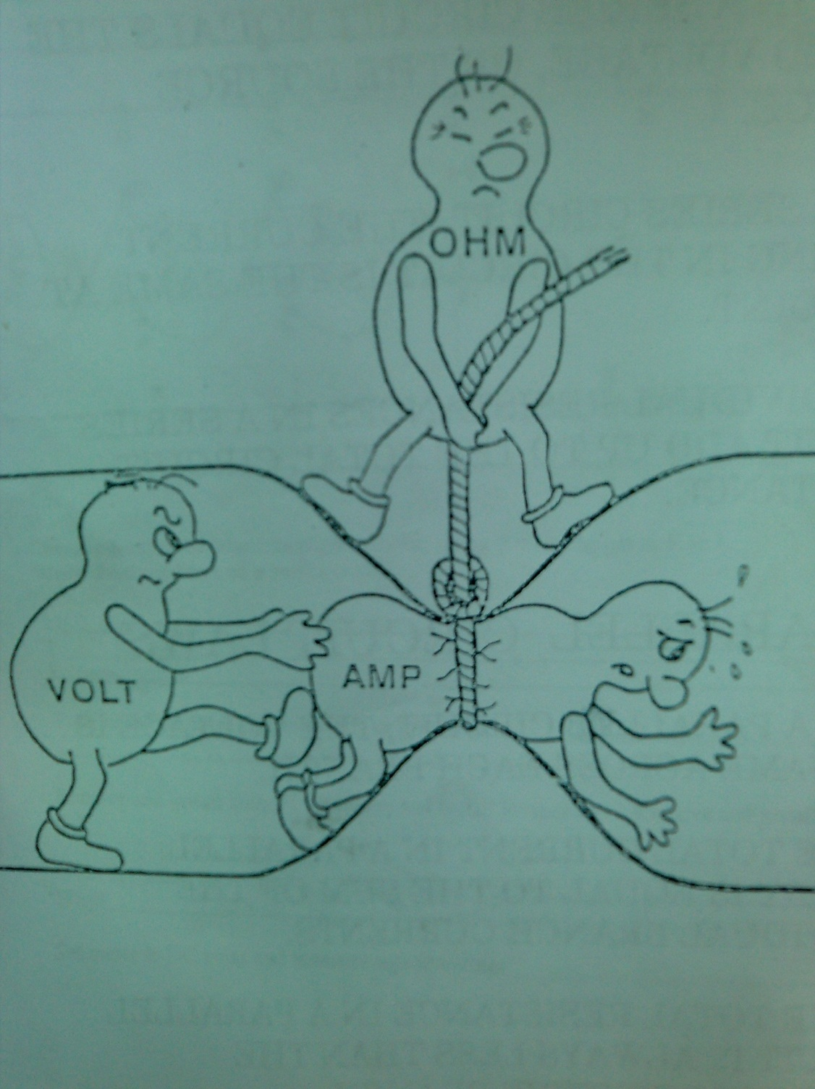
What really happens inside an electric circuit:

Slide 10
Imagine an electric circuit composed of an infinite number of 1-ohm resistors in a 2-dimensional grid.
$$=1 ohm$$
What is the total resistance between these two points?

Slide 11
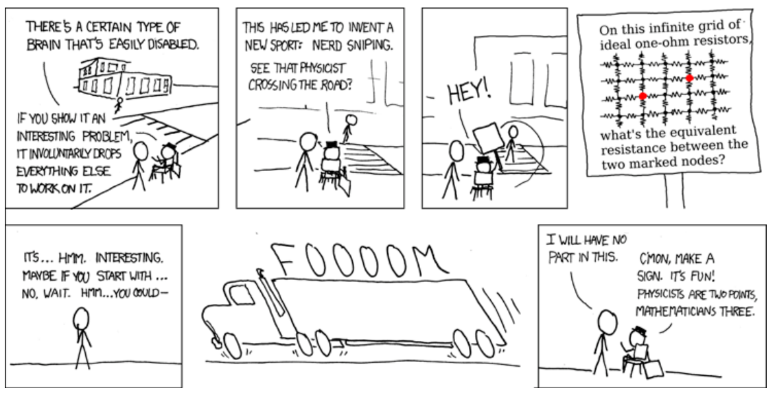
Notice that mathematicians’ brains are more expensive than physicists’ brains
xkcd by Randall Munroe
(because physicists’ brains are used).

Slide 12
Is $\sqrt{2}$ rational?
And now back to $\sqrt{2}.$
Assume it is.
Then $\sqrt{2}= \frac{a}{b} , \left\{a, b ∈ ℤ\right\}$

Slide 13
$$if \sqrt{2}=\frac{a}{b}, \left\{a,b∈ℤ\right\} , then$$
$\frac{a}{b}=\sqrt{2}$ ,
$\frac{a}{b}=\sqrt{2}$ ,
$$\left\{a,b ∈ ℤ\right\}$$
$$\left\{a, b ∈ ℤ\right\}$$
$$\sqrt{2}=\frac{a}{b}= \frac{2c}{2d}=\frac{c}{d}$$
$$= \frac{2e}{2f}= \frac{e}{f}=…$$
$\frac{a^{2}}{b^{2}}= 2$ ,
$a^{2}= 2 b^{2}$,
$$\left\{a, b, c,d,e,f…∈ ℤ\right\}$$
$∴a is even$,
$$\left\{a, b, c∈ ℤ\right\}$$
$a= 2 c$,
$$a>b>c>d>e>f>…>0$$
$$4 c^{2}$$
$2 c^{2}= { b}^{2}$
$$a^{2}$$
$=2 b^{2}$
$∴b is even$,
$$\left\{a, b, c,d∈ ℤ\right\}$$
$b= 2 d$,
$$∴\sqrt{2} is irrational.$$

Slide 14
$$if \sqrt{3}=\frac{a}{b}, \left\{a,b∈ℤ\right\} , then$$
$$\sqrt{3}=\frac{a}{b}= \frac{3c}{3d}=\frac{c}{d}$$
$$= \frac{3e}{3f}= \frac{e}{f}=…$$
$$\left\{a, b, c,d,e,f…∈ ℤ\right\}$$
$$a>b>c>d>e>f>…>0$$
$$∴\sqrt{3} is irrational.$$

Slide 15
$$if \sqrt{4}=\frac{a}{b}, \left\{a,b∈ℤ\right\} , then$$
$$\sqrt{4}=\frac{a}{b}= \frac{4c}{4d}=\frac{c}{d}$$
$$= \frac{4e}{4f}= \frac{e}{f}=…$$
No.
$$\left\{a, b, c,d,e,f…∈ ℤ\right\}$$
It will be left as an exercise for the reader to figure out why this proof breaks down for $\sqrt{4}$.
$$a>b>c>d>e>f>…>0$$
$$∴\sqrt{4} is irrational ???$$

Slide 16
So there are no integers
$$\left\{a, b ∈ℤ\right\}$$
such that
$$a^{2}=2 b^{2}$$
The best we can hope for is
$$a^{2}=2 b^{2}±1$$
And there are plenty of these:
$$1^{2}=2 \left(0^{2}\right)+1$$
$$1^{2}=2 \left(1^{2}\right)−1$$
$$3^{2}=2 \left(2^{2}\right)+1$$
$$7^{2}=2 \left(5^{2}\right)−1$$
$${17}^{2}=2 \left({12}^{2}\right)+1$$
$${41}^{2}=2 \left({29}^{2}\right)−1$$

Slide 17
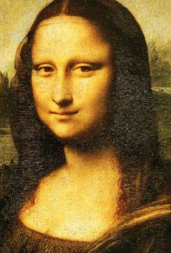
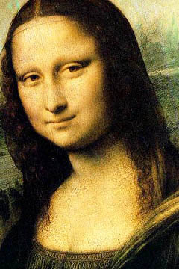
Could there be an infinite sequence of whole numbers
such that
?
$$\left\{a, b ∈ℤ\right\}$$
$$a^{2}=2 b^{2}±1$$
An infinite sequence of integers with ratios that approximate an irrational number?
Really?
Really?

Slide 18
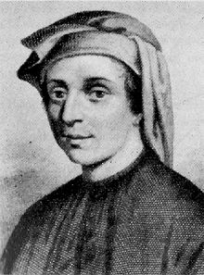
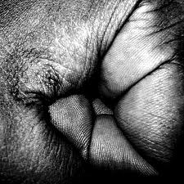
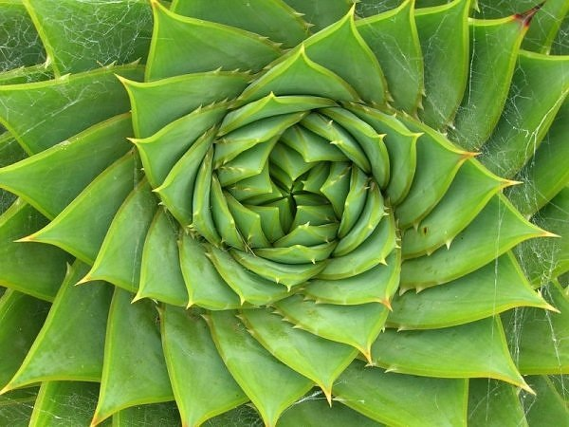
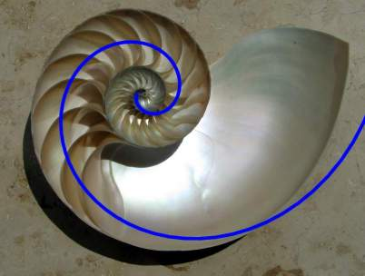
The Fibonacci Sequence
0, 1, 1, 2, 3, 5, 8, 13, 21, 34, 55, 89, 144, 233…
ϕ
$$F_{0}=0, F_{1}=1, F_{n+2}=F_{n+1}+F_{n}$$
$$=\frac{1}{2}\left(1+\sqrt{5}\right)$$
$$\frac{3}{2}=1.5$$
$$\frac{5}{3}=1.66…$$
∞
$$=1.618034…$$
$$\frac{8}{5}=1.6$$
$$\frac{13}{8}=1.625$$
$$\frac{21}{13}=1.615…$$
$$\frac{34}{21}=1.619…$$
$$\frac{55}{34}=1.6176…$$
$$\frac{89}{55}=1.6181…$$
$$\frac{F_{16}}{F_{15}}=1.618033…$$

Slide 19
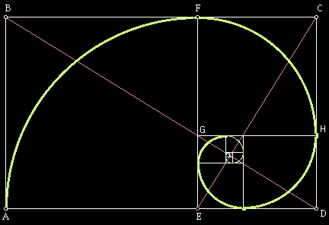
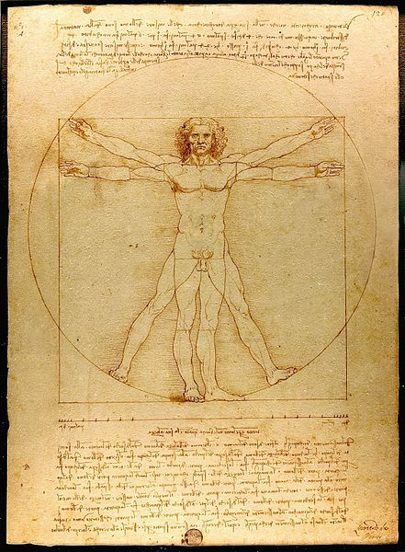
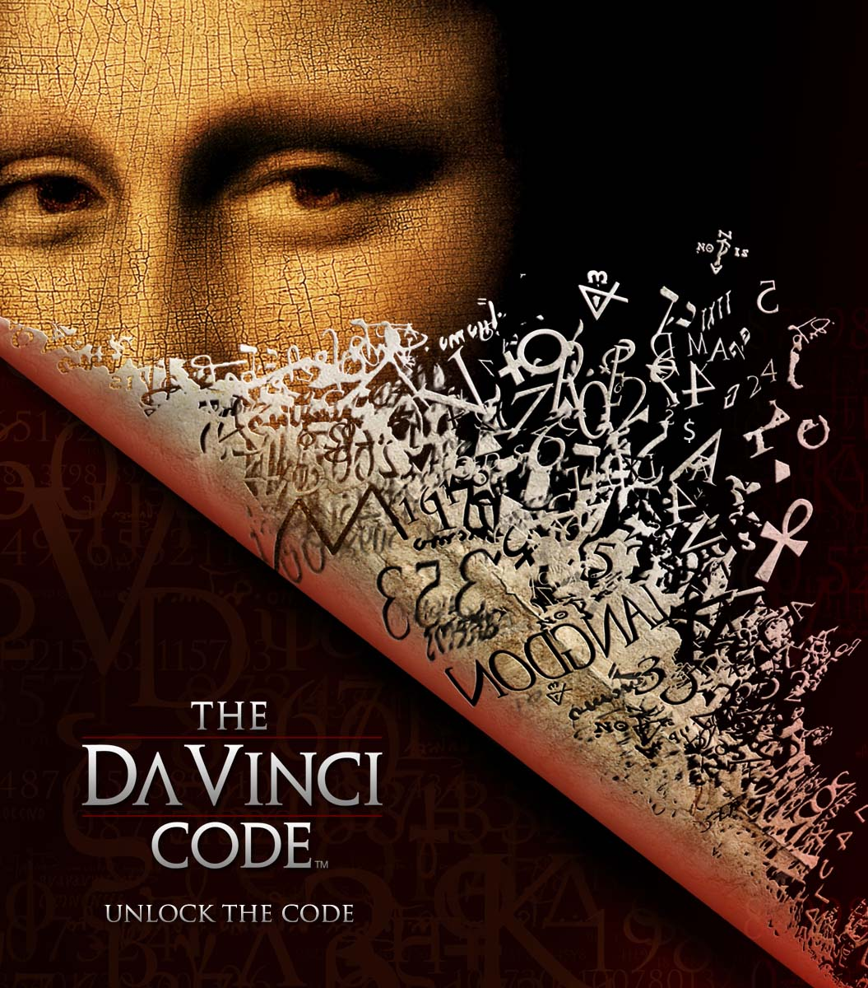
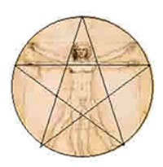
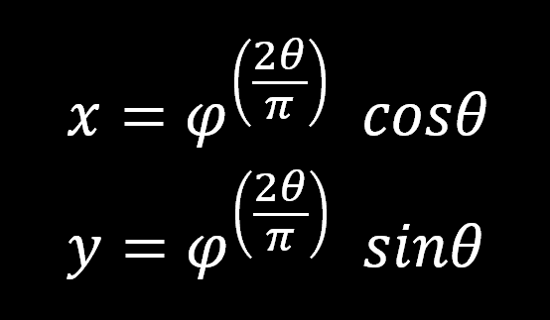
The Golden Ratio: ϕ = 1.61803398874989…

Slide 20
The Golden Ratio: ϕ = 1.61803398874989…
$$φ≡\frac{1}{2}\left(1+\sqrt{5}\right)=\lim_{n→∞}\left(\frac{F_{n+1}}{F_{n}}\right)$$
$$F_{n+2}=F_{n+1}+F_{n} or F_{n+2}−F_{n+1}−F_{n}=0$$
Define the “next term” operator E:
For any term of a sequence S_{n} ,
E S_{n} = S_{n+1}
E² S_{n} = S_{n+2}
$$F_{n+2}−F_{n+1}−F_{n}=0 becomes {E^{2}F}_{n}−E F_{n}−F_{n}=0$$

Slide 21
We can factor this:
$${E^{2}F}_{n}−E F_{n}−F_{n}=0$$
$$\left(E^{2}−E−1\right)F_{n}=0$$
$$If E F_{n}=λ F_{n} , then λ^{2}−λ−1=0$$
$$λ_{±}=\frac{1}{2}\left(1±\sqrt{5}\right)$$
$$F_{n+2}−F_{n+1}−F_{n}=0 becomes {E^{2}F}_{n}−E F_{n}−F_{n}=0$$
$$λ_{+}=\frac{1}{2}\left(1+\sqrt{5}\right)=1.618…$$
$$λ_{−}=\frac{1}{2}\left(1−\sqrt{5}\right)=−0.618…$$

Slide 22
Just “a little” algebra shows that…
$$F_{n+1}=φ{ F}_{n}+{\left(−\frac{1}{φ}\right)}^{n}=φ{ F}_{n}+{\left(−0.618…\right)}^{n}$$
$$F_{n}=\frac{1}{\sqrt{5}}\left(φ^{n}−{\left[−\frac{1}{φ}\right]}^{n}\right)$$
Binet’s formula
$$λ_{+}=\frac{1}{2}\left(1+\sqrt{5}\right)=1.618…=φ$$
$$λ_{−}=\frac{1}{2}\left(1−\sqrt{5}\right)=−0.618…=−\frac{1}{φ}$$
(The proof will be left as an exercise for the reader.)

Slide 23
But what about $\sqrt{2 }$?
We’re looking for
$$\left\{a, b ∈ℤ\right\}$$
such that
$$a^{2}=2 b^{2}±1$$
$$1^{2}=2 \left(0^{2}\right)+1$$
$$a_{n}$$ | $$b_{n}$$ | $$a_{n}/b_{n}$$
1 | 0 | Undefined
1 | 1 | 1
3 | 2 | 1.5
7 | 5 | 1.4
17 | 12 | 1.4167
41 | 29 | 1.4138
99 | 70 | 1.4143
$$1^{2}=2 \left(1^{2}\right)−1$$
$$3^{2}=2 \left(2^{2}\right)+1$$
$$7^{2}=2 \left(5^{2}\right)−1$$
$${17}^{2}=2 \left({12}^{2}\right)+1$$
$${41}^{2}=2 \left({29}^{2}\right)−1$$
$${99}^{2}=2 \left({70}^{2}\right)+1$$

Slide 24
Notice:
$$a_{n+2}={2 a}_{n+1}+a_{n}$$
$$b_{n+2}={2 b}_{n+1}+b_{n}$$
$$If E a_{n}=λ a_{n} , then λ^{2}−2λ−1=0$$
$$λ_{−}=\left(1−\sqrt{2}\right)=\frac{−1}{1+\sqrt{2}}=−\frac{1}{λ_{+}}$$
$$λ_{±}=\left(1±\sqrt{2}\right)$$
$$a_{n}$$ | $$b_{n}$$ | $$a_{n}/b_{n}$$
1 | 0 | Undefined
1 | 1 | 1
3 | 2 | 1.5
7 | 5 | 1.4
17 | 12 | 1.4167
41 | 29 | 1.4138
99 | 70 | 1.4143
$$Let λ=\left(1+\sqrt{2}\right)$$
$$a_{n}=\frac{1}{2}\left(λ^{n}+{\left[−\frac{1}{λ}\right]}^{n}\right)$$
$$b_{n}=\frac{1}{2\sqrt{2}}\left(λ^{n}−{\left[−\frac{1}{λ}\right]}^{n}\right)$$

Slide 25
We have found an infinite number of pairs of positive integers
$$\left\{a_{n}, b_{n} ∈ℤ\right\}$$
such that
$$a_{n}≈\sqrt{2} b_{n}$$
, in fact…
$$a_{n+2}={2 a}_{n+1}+a_{n}$$
$$b_{n+2}={2 b}_{n+1}+b_{n}$$
$$a_{n}=\sqrt{2} b_{n}+{\left(−\frac{1}{λ}\right)}^{n}$$
$$a_{n}$$ | $$b_{n}$$ | $$a_{n}/b_{n}$$
1 | 1 | 1
3 | 2 | 1.5
7 | 5 | 1.4
17 | 12 | 1.4167
41 | 29 | 1.4138
99 | 70 | 1.4143
$$a_{n}$$ | $$b_{n}$$ | $$a_{n}/b_{n}$$
1 | 1 | 1
3 | 2 | 1.5
7 | 5 | 1.4
17 | 12 | 1.4167
41 | 29 | 1.4138
99 | 70 | 1.4143
239 | 169 | 1.41420
$$a_{n}$$ | $$b_{n}$$ | $$a_{n}/b_{n}$$
1 | 1 | 1
3 | 2 | 1.5
7 | 5 | 1.4
17 | 12 | 1.4167
41 | 29 | 1.4138
99 | 70 | 1.4143
239 | 169 | 1.41420
577 | 408 | 1.414216
$$a_{n}$$ | $$b_{n}$$ | $$a_{n}/b_{n}$$
1 | 1 | 1
3 | 2 | 1.5
7 | 5 | 1.4
17 | 12 | 1.4167
41 | 29 | 1.4138
99 | 70 | 1.4143
$$Let λ=\left(1+\sqrt{2}\right)$$
$$\left| \sqrt{2} −\frac{a_{n}}{b_{n}} \right|<\frac{1}{\left(2.414\right){ \left(b_{n}\right)}^{2}}$$
$$a_{n}=\frac{1}{2}\left(λ^{n}+{\left[−\frac{1}{λ}\right]}^{n}\right)$$
$$b_{n}=\frac{1}{2\sqrt{2}}\left(λ^{n}−{\left[−\frac{1}{λ}\right]}^{n}\right)$$

Slide 26
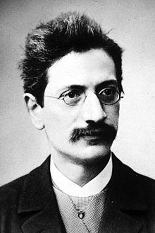
Hey… Doesn’t this have something to do with…
Hurwitz’ Theorem!
For any irrational number z there exists an infinite number of pairs of integers a, b, such that
$$\left| z−\frac{a_{n}}{b_{n}} \right|<\frac{1}{\sqrt{5}{ \left(b_{n}\right)}^{2}}$$
Adolf Hurwitz!

Slide 27
We have found an infinite number of pairs of positive integers
$$\left| \sqrt{2} −\frac{a_{n}}{b_{n}} \right|<\frac{1}{\left(2.414\right){ \left(b_{n}\right)}^{2}}$$
$$\left\{a_{n}, b_{n} ∈ℤ\right\}$$
such that
in fact…
we’ve found all of them!
Assume someone finds
$$\left\{a_{n}, b_{n} ∈ℤ\right\}$$
not on our list.
Define
$$a_{n−1}={2 b}_{n}−a_{n}$$
$$b_{n−1}=a_{n}−b_{n}$$
$If {\left(a_{n}\right)}^{2}−2$ ${\left(b_{n}\right)}^{2}=±1 then {\left(a_{n−1}\right)}^{2}−2 {\left(b_{n−1}\right)}^{2}=∓1$
Repeating this procedure will lead to
$$a_{1}=1,$$
and
$$b_{1}=1$$

Slide 28
There are two types of (real) irrational numbers
Algebraic
Transcendental
$$\sqrt{2}$$
$$π$$
For any irrational number z there exists an infinite number of pairs of integers a, b, such that
$$\frac{1}{2}\left(1+\sqrt{5}\right)$$
$$\ln{5}$$
$$3\sqrt{7}−\sqrt[5]{13}$$
$$\left| z−\frac{a_{n}}{b_{n}} \right|<\frac{1}{\sqrt{5}{ \left(b_{n}\right)}^{2}}$$
$$Arctan\left(7\right)$$
roots of finite polynomials with rational coefficients
roots of infinite polynomials with rational coefficients

Slide 29
Solve:
$$0=\frac{3}{2}−\frac{1}{2!}{ x}^{2}+\frac{1}{4!}{ x}^{4}$$
$$x=\sqrt{6}≈\frac{485}{198}$$
Solve:
$$0=\frac{3}{2}−\frac{1}{2!}{ x}^{2}+\frac{1}{4!}{ x}^{4}−\frac{1}{6!}x^{6}+\frac{1}{8!}x^{8}−\frac{1}{10!}x^{10}…$$
$$x=\frac{2π}{3}≈\frac{710}{339}$$

Slide 30
What does any of this have to do with the Google problem???
$$=1 ohm$$
What is the total resistance between these two points?

Slide 31
What really happens inside an electric circuit:

Slide 32
What is the total resistance between these two points?
Resistance
$$=1 ohm$$
What is the total resistance between these two points?
RESISTORS
IN SERIES:
$$=2 ohms$$
What is the total resistance between these two points?
$$=3 ohms$$
Resistances in series simply add

Slide 33
The opposite of resistance is conductance.
Conductances in parallel simply add
RESISTORS
IN PARALLEL:
$$conductance= \frac{1}{resistance}$$
$$\frac{1}{R_{TOTAL}}=\frac{1}{R_{1}}+\frac{1}{R_{2}}+ …$$
Conductance increases when resistors are added in parallel.
Conductance
Resistance
$$\frac{1}{1 ohm}$$
$$1 ohm$$
$$=\frac{1}{1 ohm}+\frac{1}{1 ohm}=\frac{2}{1 ohm}$$
$$\frac{1}{2} ohms$$
$$=\frac{1}{2 ohm}+\frac{1}{1 ohm}=\frac{3}{2 ohm}$$
$$\frac{2}{3} ohms$$

Slide 34
Try some harder ones...
0, 1, 1, 2, 3, 5, 8, 13, 21, 34, 55, 89, 144, 233…
$$=\left(1 ohm\right)+{\left(\frac{1}{1 ohm}+\frac{1}{\frac{13}{8} ohms}\right)}^{−1}=\frac{34}{21} ohms$$
$$=\left(1 ohm\right)+{\left(\frac{1}{1 ohm}+\frac{1}{\frac{5}{3} ohms}\right)}^{−1}=\frac{13}{8} ohms$$
$$=\left(1 ohm\right)+{\left(\frac{1}{1 ohm}+\frac{1}{2 ohms}\right)}^{−1}=\frac{5}{3} ohms$$
$$= 2 ohms=\frac{2}{1} ohms$$
$$="∞" ohms=\frac{1}{0} ohms$$

Slide 35
0, 1, 1, 2, 3, 5, 8, 13, 21, 34, 55, 89, 144, 233…
…
$$Total resistance of blue resistors=R ohms$$
$Total resistance of all resistors=R ohms$
$$R=\left(1\right)+{\left(\frac{1}{1}+\frac{1}{R}\right)}^{−1}=\frac{2 R+1}{R+1}$$
$$R^{2}= R +1$$
$$R+R^{2}=2 R+1$$
$$R=\frac{1}{2}\left(1+\sqrt{5}\right)=φ=1.61803…$$

Slide 36
…
…
$$Total resistance of all resistors=\sqrt{2} ohms$$
$$Total resistance of all resistors=φ ohms$$
ϕ
∞

Slide 37
…
…
$$Total resistance of all resistors=\sqrt{3} ohms$$
ϕ
∞

Slide 38
…
…
$$Total resistance between the red dots=\frac{1}{\sqrt{3}} ohms$$

Slide 39
But we still don’t know how to solve this!
$$=1 ohm$$
What is the total resistance between these two points?

Slide 40
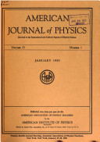
Surprise!
Leo Lavatelli, American Journal of Physics,
Volume 40, pg 1248,
September 1972
“The Resistive Net and Finite-Difference Equations”

Slide 41
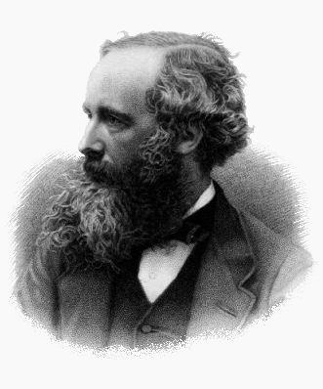
Surprise #2!
James Clerck Maxwell
1831 - 1879

Slide 42
Label the currents with indices to denote locations in the circuit.
$$I_{−1}$$
$$I_{0}$$
$$I_{1}$$
$$I_{2}$$
$$I_{3}$$
Kirchhoff’s loop rule:
$$I_{0}−4 I_{1}+I_{2}=0$$
$$I_{n}−4 I_{n+1}+I_{n+2}=0$$
$$Let E I_{n}=I_{n+1}$$
$$\left(1−4E+E^{2}\right)I_{n}=0$$
$$Eigenvalues: E I_{n}=λ{ I}_{n}$$
$$λ=2+\sqrt{3}$$

Slide 43
Particular solution:
$$I_{ext}$$
$$I_{−1}$$
$$I_{0}$$
$$I_{1}$$
$$I_{2}$$
$$I_{3}$$
$$For all n<0, { I}_{n}=\frac{1}{λ} I_{n+1}$$
$$For all n>1, { I}_{n}=\frac{1}{λ} I_{n−1}$$
$$I_{ext}−I_{0}+4 I_{1}−I_{2}=0$$
$$\left(I_{ext}−I_{0}+I_{1}\right)R=V$$
$$I_{0}=−I_{1} and I_{2}=\frac{1}{λ} I_{1}$$
$$λ=2+\sqrt{3}$$
$$R=\frac{1}{\sqrt{3}} ohms$$

Slide 44
This method generalizes to 2 dimensions!
$$I_{−1,1}$$
$$I_{0,1}$$
$$I_{1,1}$$
$$I_{2,1}$$
$$I_{3,1}$$
$$I_{−1,0}$$
$$I_{0,0}$$
$$I_{1,0}$$
$$I_{2,0}$$
$$I_{3,0}$$
$$I_{−1,−1}$$
$$I_{0,−1}$$
$$I_{1,−1}$$
$$I_{2,−1}$$
$$I_{3,−1}$$

Slide 45
This method generalizes to 2 dimensions!
$$E_{x} I_{m, n}=I_{m+1, n}$$
$$E_{y} I_{m, n}=I_{m, n+1}$$
Horizontal and vertical equations are inseparable.
Current loops influence each other in a nonlinear way.

Slide 46
Interactions of two current loops: 1D chain
A
B

Slide 47
Interactions of two current loops: 2D array
A
B

Slide 48
Complexity of solutions of 2D grids
Number of rows Order of polynomials Number of equations
1
2
1
Fortunately the infinite dimensional 2D grid is “simpler” than a grid with 20 infinite rows.
2
4
2
3
6
6
But a full solution involves multivariate calculus and the creation of appropriate Green’s functions.
7
14
924
20
40
35 billion

Slide 49
$$=1 ohm$$
What is the total resistance between these two points?
Finite element:
$$1 ohm$$
Infinite 1-D chain:
$$\frac{1}{\sqrt{3}} ohms$$
Infinite 2-D array:
$$\frac{1}{2} ohms$$

Slide 50
$$=1 ohm$$
What is the total resistance between these two points?
Finite element:
$$1 ohm$$
Infinite 1-D chain:
$$\frac{\sqrt{3}}{2} ohms$$
Infinite 2-D array:
$$\frac{2}{π} ohms$$

Slide 51
$$=1 ohm$$
What is the total resistance between these two points?
Finite element:
$$\frac{7}{5} ohm$$
Infinite 1-D chain:
$$\left(\frac{4}{\sqrt{3}}−1\right) ohms$$
Infinite 2-D array:

Slide 52
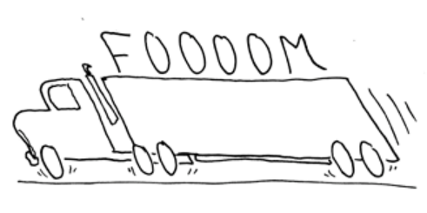
You have been nerd sniped.
It will be left as an exercise for the reader to derive the resistance for an infinite 2D array.
All of the information you need is in the references, which are right here…

Slide 53
References:
Lavatelli, L., “The Resistive Net and Finite-Difference Equations,” American Journal of Physics, Volume 40, pg 1248,
Gardner, M., “The Calculus of Finite Differences,” reprinted in The Colossal Book of Mathematics, Norton & Co., 2001
Levine, L., “The Calculus of Finite Differences,” http://www.math.cornell.edu/~levine , Jan 2009
MathPages.com, “Infinite Grid of Resistors,” http://mathpages.com/home/kmath668/kmath668.htm
Munroe, R., xkcd.com
September, 1972

Slide 54
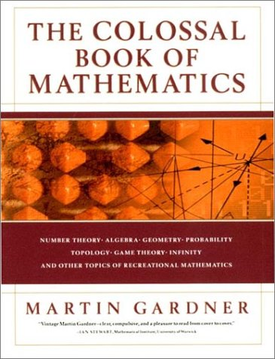
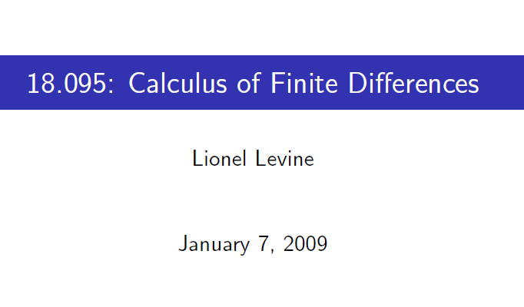

Slide 55
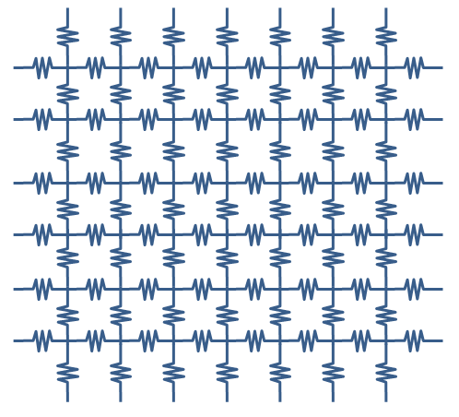
By the way, the answer is…
$$R= \frac{8 − π}{2π} ohms$$

Slide 56
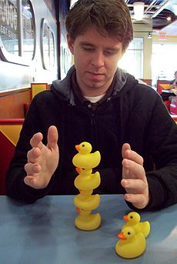
DOOR PRIZES!
Pesonally signed by randall munroe

Slide 57
grownups

Slide 58
purity

